Slide 1
“一带一路”下的绿色思维
Think in green under “Belt & Road” Initiative
中国节能环保集团公司董事长
王小康
Mr. Xiaokang WANG, Chairman of CECEP

Slide 2
1
中国在“绿色丝绸之路”中必将发挥重要作用
China is poised to make significant impact on green actions of the Belt & Road Initiative
2
探索"绿色合作"的突破点
To explore the spearhead of "green cooperation"
3
对未来区域合作的建议
Suggestions for regional cooperation in future
4

Slide 3
中国必将发挥重要作用
China is poised to make significant impact on green actions of the Belt & Road Initiative

Slide 4
中国在“绿色丝绸之路”中必将发挥重要作用
中国应成为理念输出国。
China should be an idea exporter
中国对于经济发展与环境的关系认识和体会更为深刻。
Knowing from what it has been through, China has deeper understanding on balance between economic growth and environment.
中国节能环保产业已积累较大的优势。
Long-accumulated advantages has been gaining in energy-saving and environmental protection industry in China

Slide 5
在探索人与自然和谐共存、经济发展和环境保护协调发展的背景下，中国率先提出“生态文明；
China took the lead to propose the concept of "ecological civilization"
这一思路，是发展理念、发展道路和发展模式的进步； An upgrade of development in concept, path and models
生态文明的理念不仅指导了“美丽中国”建设，对于其他国家同样具有价值。
Not only a direction of building the "beautiful China", but would also be a valuable inspiration to other countries
党的十八大报告明确提出，把生态文明建设放在突出地位，努力建设“美丽中国”。
The notion of ecological civilization and to build a "beautiful China" has been incorporated into the report to the Eighteenth National Congress of the Communist Party of China (CPC)

Slide 6
中国节能环保产业发展迅速
Fast growing industry of energy conservation and environmental protection
七大战略性新兴产业发展之首
place the first among the seven strategic emerging industries
产业技术装备在不断升级，形成了门类较为齐全的产业体系
industrial system has been built with extensive array of sub-divisions, along with continuous upgrading of technology and equipment
“十二五”期间，中国节能环保产业以年均15%-20%的速度增长
A boosting industry with average growth rate of 15%-20% p.a. during period of the12th five-year plan

Slide 7
中国节能环保产业发展迅速
Fast growing industry of energy conservation and environmental protection
2014年，中国节能环保产业总产值约为3.98万亿元，今年预计将达到4.5万亿元
Gross output of the industry in 2014: 3.98 trillion RMB, estimated figure in 2015: 4.5 trillion RMB
全国环保企业数量从2005年不足3000家快速增长到2014年约5万家。
Number of companies in the trade: ≦3000 in 2005 to ≈50,000 in 2014

Slide 8
探索绿色合作的突破点
To explore the spearhead of "green co-op"
绿色基础设施建设 Relevant infrastructure
节能环保产业园建设 Eco-park projects

Slide 9
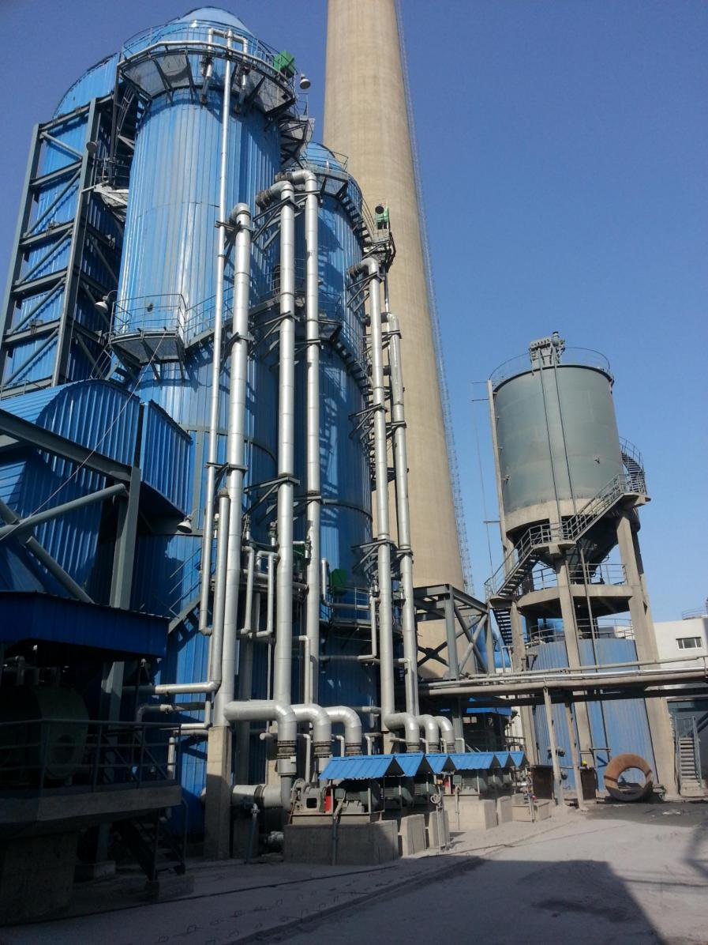
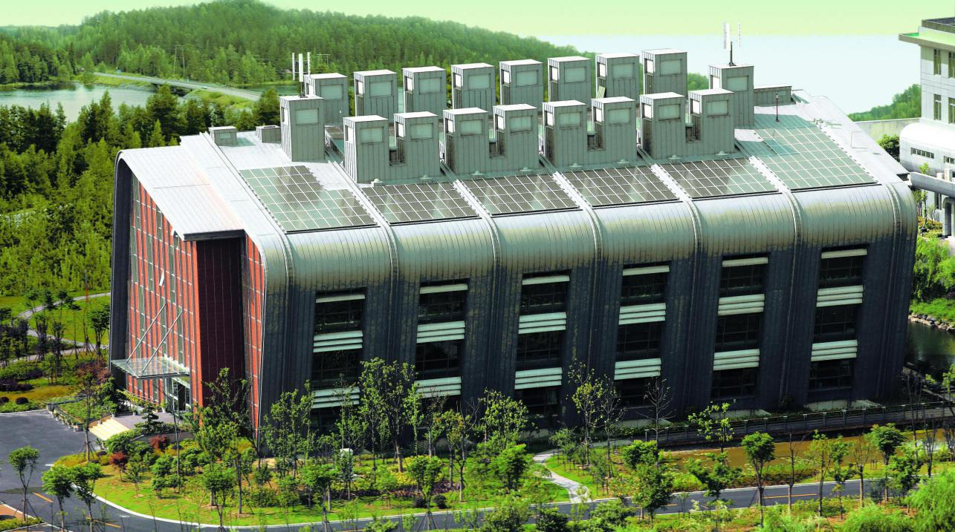
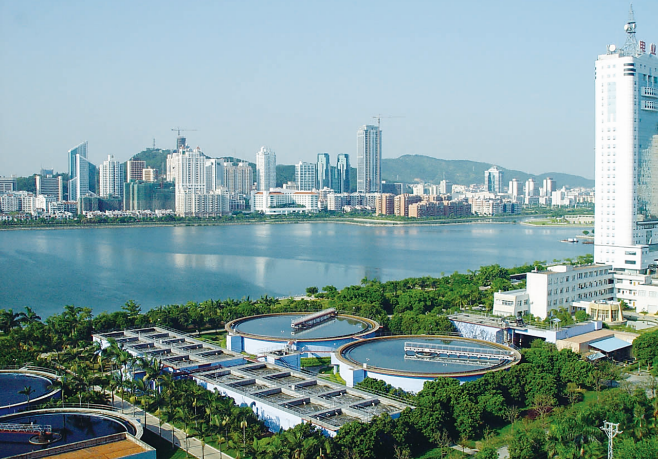
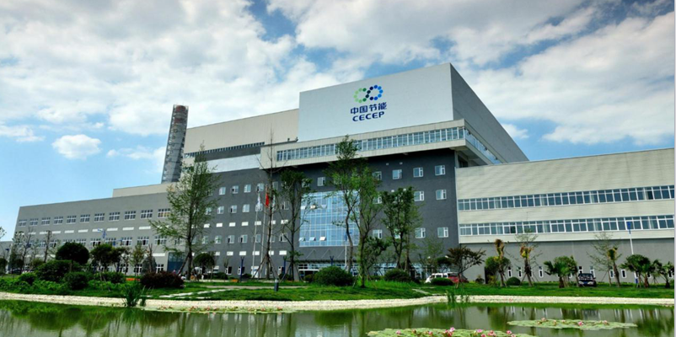
绿色基础设施建设
Infrastructure

Slide 10
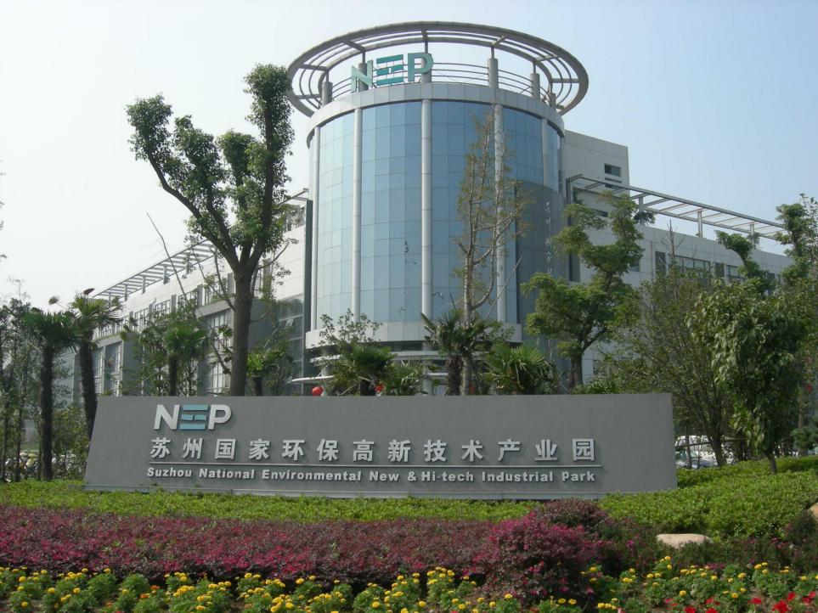
节能环保产业园建设 Eco-Park
园区主要经济指标：年均增幅达30%左右；Avg growth rate of 30% p.a.
经济总量：增长160多倍；Economic output: 160 times of increase
累计上交各类税收：超千亿元；Accum. tax paid: over 100 billion RMB
以占苏州市3.4%的土地、7.4%的人口创造了15%左右的经济总量：7.4% of population, use 3.4% of land to create 15% economic output in Suzhou
累计引进外资项目：5029个；Projects with introduction of foreign investment : accum. 5029
累计实际利用外资：248亿美元；Actual utilization of foreign capital: accum. USD 24.8 billion
累计引进世界500强企业：91家；No. of Fortune500 company: accum. 91
投资上亿美元项目：近150个；Projects with investment over USD 100 million: nearly 150
97人入选国家“千人计划”：
97 experts get selected into national "Thousand Talents Program"
吸引人才：外国专家1000余人;外籍人才6000人;海外归国人才4000余人。Attract over 1000 foreign specialists, 6000 foreign talents, over 4000 returned talent
苏州环保产业园
National Environmental Industrial Park in Suzhou
中国政府和新加坡政府联合投资运营
Co-invested and co-operated by governments of China & Singapore

Slide 11
对未来合作的建议
Suggestions for future collaboration

Slide 12
“一带一路”沿线国家应形成可持续发展的共识，为国际间的绿色合作提供多层次的组织保障和创新的政策支持。
Consensus need to be made among countries along the "Belt & Road" so as to provide multi-level organizational guarantees and innovative policy support
项目审批 project approval
财政税收 fiscal and tax
金融债券 financial bond
外事管理 foreign affairs administration
海关监管 customs control
合作区域扩大 expand the cooperative region

Slide 13
谢谢各位！
Thank you!

