Slide 1
Global Green Growth Institute:
Its Role in Delivering Green Growth
Nov. 11th, 2015
Yvo de Boer
Director-General
Global Green Growth Institute (GGGI)

Slide 2
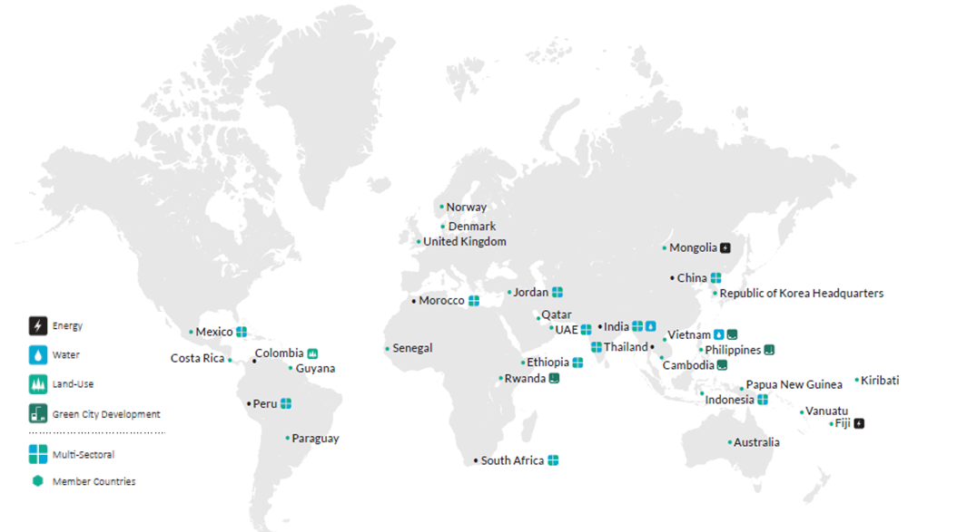
GGGI At-a-Glance
Established as a treaty-based international organization in 2012 成立于2012年
24 Member countries 24个成员国
“A resilient world of strong, inclusive and sustainable growth."
一个因强劲、包容而可持续的增长而充满活力的世界

Slide 3
GGGI Value Chain 的价值链
GGGI’s Delivery Model 的服务模式
is based on in-country on-the-ground projects and global products and services integrated in a reinforcing and virtuous circle.
Green Growth Planning and Implementation (GGP&I) 绿色增长规划与实施部门
is responsible for in-country delivery in 22 countries with 34 projects; embedded within partner governments as trusted advisors and driven by national development priorities
Supported by Knowledge Solutions Division (KSD) 技术方案部门
focuses on producing cutting-edge, policy-relevant knowledge products and services; creating an enabling environment for green growth investments
Notes:
Value Chain reflects a green growth planning and implementation approach from Diagnosis, Green Impact Assessment, Sector/sub-sector Strategy and Planning, Project design, Financing and Implementation - highlight implementation within GGGI context
This is followed by a systematic appraisal process, which captures learning from programs and ensures the robustness of GGGI advice and assistance.
Clear consensus from our donors and Members that our work on green growth planning moves towards tangible implementation
There is an emphasis on bankability of projects: GGGI seeks to play a catalytic role in mobilizing financing for implementable green growth plans
Green Growth Planning and Implementation (GGP&I) division is GGGI’s key interface with partner governments. They own in-country relationships and the responsibility for overall delivery results.
KSD underpins the relevance, efficiency and effectiveness of our in-country delivery and provide a robust feedback loop between knowledge and investment services and global green growth products and services through two integrated work streams
Knowledge Services – knowledge development, sharing and management activities which build a strong theoretical and empirical base for green growth planning while providing concrete/practical options, guidance and capacity development for policymakers and investors tailored to national context
Green Investment Advisory Services – to identify innovative financing mechanisms and improve the conditions for public and private green investments.

Slide 4
Plans to Action: Global Projects 从规划到实施：项目实例
Philippines 菲律宾
Colombia 哥伦比亚
Jordan 约旦
Ethiopia 埃塞俄比亚
Supported the design and operationalization of the Sector Reduction Mechanism and CRGE Facility which aims to attract, manage and deploy climate finance in prioritized investment
帮助建立实施行业减排机制，帮助重点行业吸引气候融资
Demonstration of the Eco town Framework Project has led to Phase 2 which aims to replicate and scale up CRGG planning at sub-national levels
生态城的示范项目成功进入第二阶段，计划在省级层面开展实施绿色发展项目
Supported in designing and establishing a Payment-for-Performance agreement aimed at promoting a zero net deforestation goal
与挪威和德国合作，支持建立绩效收费制度
Support GoJ in the development of a National Green Growth Plan which includes the design of policy framework and implementation roadmap
帮助建立国家绿色发展规划，政策框架和实施路线图
Cross-cutting for in-country delivery : Poverty reduction, Safeguards, Gender 跨领域国家项目：减贫、保障机制、性别公平
Alignment and contribution towards the Post-2015 Sustainable Development Goals 与后2015可持续发展目标保持一致
Notes:
We deliver green growth programming in developing Asia, Middle East, Africa and Latin America. We are in the process of implementing the country strategies across our programmatic portfolio to ensure coherence to organizational strategy and post-2015 SDGs. Some examples of our current work:
Philippines: Supporting government in integrating climate-resilient green growth planning through the Eco-town Framework – we developed an ecotown model that the President wants to see replicated in 150 municipalities next year and 150 the year after .
Colombia: Supporting government in establishing a USD 65 million payment for performance fund aimed at addressing deforestation in the country; final stages of concluding this agreement with governments of Norway and Germany financing the PfP initially. UK has expressed interest.
Jordan: Supporting the government in developing its national strategy for green growth and in establishing mechanism to improving inter-institutional coordination and green growth knowledge sharing.
Ethiopia: Supporting government in implementing the Climate Resilient Green Economy strategy; attracting and deploying financing through the >30 million dollar CRGE Facility
India: Supporting the government in Prioritizing and shortlisting investment opportunities to improve environmental sustainability while also promoting socially-inclusive economic growth.

Slide 5
Knowledge Solutions Division has different skills to support GGGI work globally and in countries 技术部门提供有针对性的方案
Assistance to design and prepare projects
帮助项目提案
Investment specialists
投资领域专家
Sector specialists
行业专家
Knowledge platform
知识平台
Project preparation 项目准备
Funds and institutions
基金等
Climate finance 气候金融投资
Public and private finance公私金融合作
Risk
风险评估
Energy 能源
Develop global products, platforms, templates
开发全球性产品平台和模板
Water 水资源
Tools
工具
Connect and access to finance
促进投资
Land Use / Forestry
土地利用/林业
Capacity development
能力建设
Cities 城市
G20 GreenInvest
G20绿色投资
1.Globally usable tools 全球性工具
2. Design and develop projects that can access finance 开发可融资项目
3. Build domestic financial institutions 建立国内金融体制

Slide 6
Green Investment Advisory Services 绿色投资服务
Design & Develop Bankable Projects
开发设计可融资项目
Design & Develop Financial Products to Mitigate Risks
开发设计产品以规避投资风险
Help Design & Develop Domestic Financial Institutions
帮助建立国内金融投资体系

Slide 7
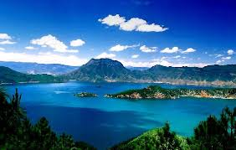
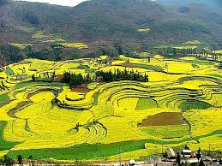
GGGI as a Global Knowledge Platform for China
中国与世界分享知识和经验的平台
Scoping Green Growth opportunities in China
识别中国绿色发展的机遇
Develop Roadmap of Green Growth of China in
13th FYP and beyond 开发中国十三五绿色发展路线图
Support to establish modalities for accessing climate finance – trial at pilot level 帮助开展绿色金融试点评估
Green-screening foreign investment flows 建立海外投资绿色化战略
Pilot effort on province/city green transition practice
帮助绿色转型试点城市开展实施工作
South-South Cooperation and knowledge sharing 南南合作与知识共享

Slide 8
Thank You !

