Slide 1
The EU's agenda on financing for environmental sustainability
欧盟可持续发展融资议程
Daniel Calleja 丹尼尔.伽列禾
Director General Environment, European Commission
欧盟委员会环境总司总司长

Slide 2
Contents 内容
1
Introduction 简介
2
EU policy context 欧盟政策框架
3
Example Circular Economy循环经济实例
4
Financing for climate and SDGs
气候与可持续发展目标融资

Slide 3
Introduction 简介
Share EU experiences and learn about China's recent initiatives in green finance
分享欧盟经验 并了解中国在绿色融资领域的实践
UNEP Inquiry into the Design of a Sustainable Financial System
联合国环境署倡议设计可持续金融体系
Paper prepared by CCICED for this AGM "Green Finance Reform and Green Transformation"
国合会年会‘绿色金融改革和绿色转型’讨论稿
Huge investment needs to meet environmental objectives in China and EU
中国和欧盟为实现环境目标需要巨大的投资
➔ leverage private capital 利用私有资本

Slide 4
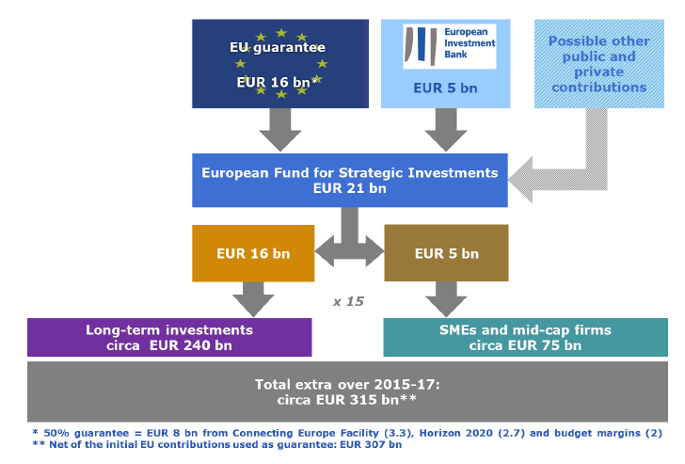
EU policy context 欧盟政策框架
European Fund for Strategic Investment (EFSI) 欧洲战略投资基金

Slide 5
EU policy context (2) 欧盟政策框架 2
Capital Markets Union Action Plan (CMU)
资本市场联合行动计划
Increase and diversify the funding sources for Europe’s businesses and long-term projects
增加并多样化欧洲企业和长期项目的资金来源
Create the right conditions to enable long-term and infrastructure investments
创造长期基础设施投资的适当条件
Harness finance to deliver environmental sustainability
运用融资实现环境的可持续

Slide 6
EU policy context (3) 欧盟政策框架3
Investors need information on environmental, social and governance (ESG) impacts
投资者需要环境、社会和治理影响的信息
EU Directive on the disclosure of non-financial and diversity information, addressed at larger companies in the EU
欧盟对公开非金融和多样化信息的指令在欧盟众多大
型企业得以落实
Need for the right framework conditions:
需要适当的政策框架
Fossil fuel phase out: the Commission encourages EU Member States in sharing best practices 淘汰化石燃料：欧委会鼓励各成员国分享最佳实践经验

Slide 7
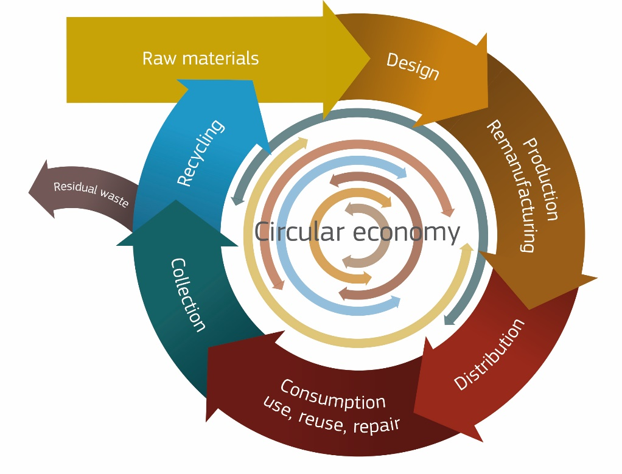
Example Circular Economy 循环经济实例
Many players, innovative, smaller = risky projects
多方参与，创新，小规模=有风险的项目
Support for research & innovation through Horizon 2020
通过欧盟地平线2020支持科技创新
Support to SMEs through COSME
通过COSME支持中小企业
LIFE funding for environmental projects 环境项目由 LIFE资金支持
Support for eco-innovation
支持生态创新
Support from EFSI and the EU's structural and investment funds (ESIF) 通过欧盟结构投资基金获得支持

Slide 8
Example Natural Capital Financing Facility
自然资本融资实例
EIB
欧洲投资银行
LIFE 项目
Environment / Climate
环境/气候
NATURAL CAPITAL FINANCING FACILITY自然资本融资机制
Co-investors联合投资人
private and/or public
私营和/或公共
FINANCIAL INSTRUMENTS财政工具
EUR 100-125m ← EUR 50m First Loss for EIB
1-1.25亿欧元← 欧洲投资银行5000万欧元先期
TECHNICAL ASSISTANCE
技术援助
EUR 10m1000万欧元
Investments投资
Project level
项目层面
DIRECT INVESTMENTS IN
PROJECTS 项目直接投资
INTERMEDIATED INVESTMENTS:
居间投资
Private Equity Funds 私营平等资金
Credit Lines to Banks银行信贷链

Slide 9
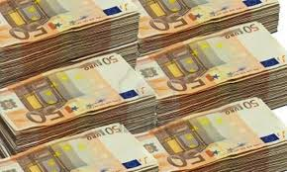
Financing for climate and SDGs
气候和可持续发展目标注资
Climate Finance – one of the big challenges to ensure the low-carbon transition
气候资金 – 低碳转型面临的最严峻
挑战之一
20% of the EU budget until 2020 for climate (internally and externally)
欧盟至2020年全部预算（对内和对
外总和）的20%将用于气候领域
European Investment Bank has a 25% climate finance target
欧洲投资银行设立25%气候投资目标

Slide 10
Financing for climate and SDGs (2)
气候和可持续发展目标注资 2
2030 Agenda for Sustainable Development
2030可持续发展议程
World Bank, IMF, MDBs:
世界银行，国际货币基金组织，
多边发展银行
need to move from 'billions' to 'trillions'
需要从‘数十亿’转向‘数万亿’
investments of all kinds needed: public and private, national and global
投资渠道多元化 – 政府或私人，国
家或全球

Slide 11
Thank You
谢谢 !

