Slide 1
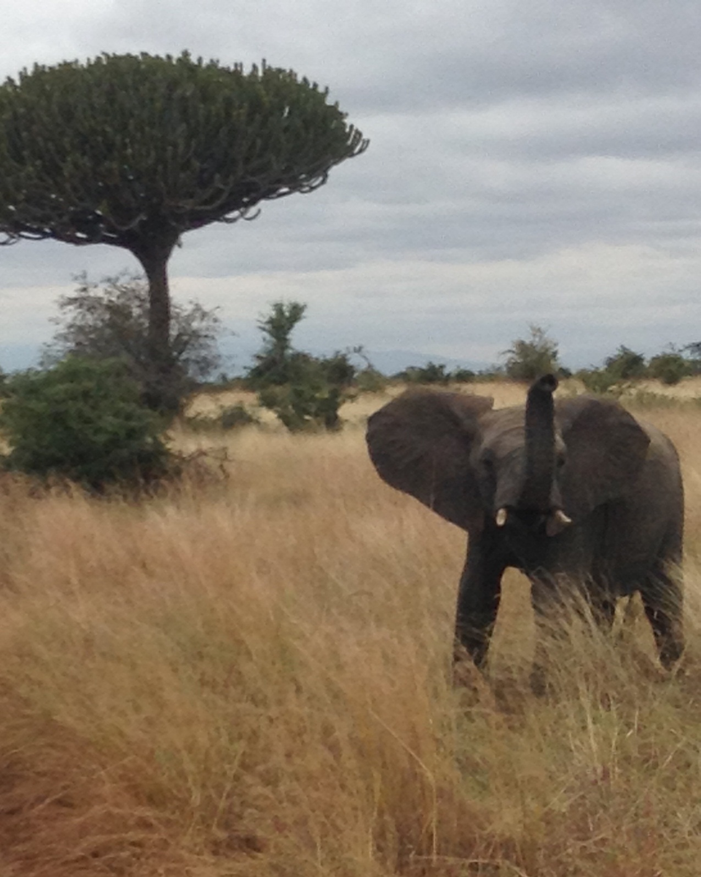
Protecting Wildlife by Combatting its Illegal Trade 保护野生动物，打击非法贸易
CCICED
Presentation by Peter Kent
International Executive Vice Chair
December 2014
演讲人：国际常务副主席Peter Kent
2014年12月
Notes:
Opening
Good morning/afternoon.
For those of you that I had not yet had the pleasure to formally meet, I’m Peter Kent, the International Executive Vice Chair of the China Council for Phase V.
It is a sincere pleasure to be here again this year, serving in this role for the third consecutive year.
Value of the China Council
The China Council is a unique organization that brings together experts in the fields of environment and development from across the world and from within China to discuss and investigate key challenges facing this country.
The Council has provided opportunities to engage in a dialogue on a wide range of issues of interest to China and the world. In this Phase, we have an opportunity to broaden this dialogue as China has invited Council members to submit individual reports on issues that we identify to be of value and particular import.
Introduce Paper Topic
Accordingly, it is my pleasure today to present my submission to the China Council on Protecting Wildlife by Combatting its Illegal Trade. This is a complex, environmental, economic and security challenge that has gained significant prominence on the international stage, and one where China, as the largest market for illegal wildlife products, is uniquely positioned to have a substantial and positive impact.
In my brief remarks, I will take a few moments to provide an overview of this issue, highlight international and Chinese actions to tackle wildlife crime, and propose opportunities for further government action and study by the China Council.

Slide 2
Illicit Wildlife Trade on the Rise
非法野生动物贸易呈上升之势
Significant increase in the trade of illegal wildlife products since 2007
Value of the illegal trade and poaching of plants and wildlife ranges between $US 7-23 billion annually (OECD, UNEP, UNODC, INTERPOL)
2007年以来非法野生动物产品贸易显著增加
野生动物非法贸易以及偷猎的价值每年在70-230亿美元之间 (OECD, UNEP, UNODC, INTERPOL)
Notes:
Significant Increase in Global Trade
The illegal wildlife trade – the taking, trading, importing, exporting, processing, possessing, obtaining and consumption of wild fauna – in contravention of national or international law – has experienced significant global growth since 2007.
Wildlife crime has now been ranked as the fourth highest illegal activity worldwide in terms of value after narcotics, counterfeiting and human trafficking. Key international organizations, including the Organization for Economic Cooperation and Development, the United Nations Environment Program, and INTERPOL, now value the illegal trade and poaching of plants and wildlife between $US 7-23 billion annually.
This growth directly threatens endangered populations of iconic species such as rhinoceros, elephant, tiger and other wildlife, like reptiles, primates, civets and pangolins – but the consequences are much more widely spread.
Within developing countries, wildlife crime deprives governments of critical revenue, while deterring conservation, threatening biodiversity and undermining security. Capitalizing on a seemingly endless demand for both legal and illicit wildlife products, transnational criminal organizations have become major players in this black market – often using the legal trade of wildlife goods to cloak the illicit trade and exploiting jurisdictional divisions between national and international enforcement agencies.

Slide 3
International Responses
国际间反应
Sustained attention in multilateral environment agreements
Convention on International Trade in Endangered Species of Wild Fauna and Flora (CITES)
Strengthened national enforcement to combat wildlife crime
Enhanced cooperation in enforcement operations
International Consortium on Combating Wildlife Crime, INTERPOL Environmental Crime Program, Wildlife Enforcement Network
Improved technology improving enforcement outcomes
High-level, high-profile engagement
London Declaration on Illegal Wildlife Trade (February 2014)
UNEA Ministerial Dialogue on Illegal Trade in Wildlife (June 2014)
对多边环境协议持续关注
《濒危野生动植物国际贸易公约》 (CITES)
加强了国家执法，打击野生动物违法行为
在执法行动中加强了合作
打击野生动物犯罪国际联盟，国际刑警组织环境犯罪项目，野生动物执法网络
技术的提高改善了执法效果
高层、高规格合作
关于非法野生动物贸易的伦敦宣言 (2014年2月)
关于野生动物非法贸易的UNEA 部长级对话 (2014年6月)
Notes:
International Efforts
The international community has long recognized the value of wildlife preservation and in recent years, has taken action to counter the threat posed by the illicit trade.
In the 1960s, countries began coming together to regulate the trade in wildlife, with the Convention on International Trade in Endangered Species of Wild Fauna and Flora (CITES), which came into force in 1975. With a strong record of achievement and an ongoing commitment to scientific of expertise, 180 governments, including China, are now committed to working together in this important forum.
With the exponential growth of wildlife crime, key governments have increased their capacity to work nationally and in unison through organizations like INTERPOL and the International Consortium on Combating Wildlife Crime to strengthen their laws, in-country enforcement capacity, and ensure that effective penalties are in place to penalize those individuals and groups who commit wildlife crimes, and deter those that may be considering such actions in the future. Enforcement agencies are also harnessing new technologies, including identification tags, DNA testing, radio collars, and satellite imagery to prevent poachers and illegal traders from evading national laws and detection.
This ongoing work has been complemented by recent, high-level meetings that continue to build momentum for integrated global action to tackle this complex challenge. In June 2014, the High Level segment of the United Nations Environment Assembly of UNEP had a Ministerial dialogue on illicit wildlife trade and the Assembly adopted a resolution that strongly encourages member states to implement their commitments, mobilize resources, and promote cross-agency cooperation in order to also tackle the security dimensions of the illegal wildlife trade.
In February 2014, the Government of the United Kingdom, in conjunction with their Royal Family, hosted the London Conference on Illegal Wildlife Trade. Delivering $44 million in financial commitments (including a $2 million commitment from my own Government), this event built a critical mass of political support for the London Declaration – a robust roadmap for international action to eradicate the market for illegal wildlife products; ensure effective legal frameworks and deterrents; strengthen law enforcement; and, promote sustainable livelihoods and economic development.
The Declaration also set a one year timeline for action. Signatories – including China and 45 other countries - will meet again this coming March in Botswana to report on their progress in delivering on the London Declaration, as well as national progress in tackling the illicit wildlife trade. This meeting will be an opportunity to identify key challenges experienced by countries in implementing actions to combat wildlife crime that could benefit from enhanced international coordination and focus.

Slide 4
China’s Action to Combat Illegal Wildlife Trade
中国打击非法野生动物贸易的行动
Reducing domestic consumer demand
Strengthened legal frameworks
Domestic advocacy
Traditional medical practitioners
Bolstering enforcement capabilities
Engaging in regional and international enforcement operations
减少国民消费需求
强化法律框架
国内宣传
传统医药行医人员
加强执法能力
加入地区和国际执法行动
Notes:
So, how does all of this impact China?
China is the largest consumer market for wildlife and wildlife products. Food and traditional medicine have typically driven this demand. However, with growing consumer affluence, illegal wildlife products have also come to symbolize improved social status and wealth. Indeed, ‘wealth’ is replacing ‘health’ as a primary driver of illegal wildlife consumption.
The Chinese Government has taken a number of important measures to counter this growing demand:
First, the Government is strengthening legal frameworks to curtail demand. For example, in April of this year China's Standing Committee of the National People's Congress adopted an interpretation of the Criminal Law which will jail consumers of rare wild animals for food.
Second, these legal actions are supported by public awareness campaigns. Renowned Chinese celebrities, including actress Li BingBing, actor Jackie Chan, and basketball star Yao Ming, are each championing campaigns to reduce consumer demand for illegal wildlife products. This is complemented by government awareness-raising activities - through posters and information kiosks in major transportation centres, such as airports and subways.
Third, traditional Chinese Medicine practitioners and users are discussing sustainable use of wildlife products, to move away from the use of endangered plants and animals protected by national and international legislation in medicinal products.
Enforcement capabilities are also being strengthened to help China implement its “zero tolerance” policy to the illegal wildlife trade. The National Inter-Agency CITES Enforcement Collaboration Group was established in 2011 and is the largest organization in the world dedicated to combatting wildlife trafficking.
China is playing a key role in international efforts to combat the illegal wildlife trade, working in partnership with other countries and international agencies to carry out several law enforcement operations. For example, Chinese customs and law enforcement officials recently worked with partners in Africa, Southeast Asia and the United States - leading to hundreds of arrests and seizures of contraband in several countries.

Slide 5
Opportunities for Future Action
未来行动的机会
Progress in China to tackle illicit wildlife trade, but opportunity to go further
Eradicate the market for illegal wildlife products
Ensure effective legal frameworks, deterrents and strengthening law enforcement
Secure and support sustainable livelihoods and economic development
Harness current, high-level moment to advance meaningful national and international action
Report progress at the March 2015 Botswana Conference
Continue/advance cooperation within CITES and INTERPOL
中国打击非法野生动物贸易取得进展，仍有机会进一步
根除非法野生动物产品市场
确保有效法律框架与震慑力，加强执法
保障和支持可持续生活来源和经济发展
借目前高层活动推进有效的国内和国际行动
在2015年3月的博茨瓦纳大会上做进展报告
在CITES 和 INTERPOL范围内继续并推进合作
Notes:
With growing recognition of the scale, complexity and costs, there is strengthened international resolve to address the illegal wildlife trade at the national level and through enhanced international cooperation. This offers a unique opportunity for action and I urge China to continue its efforts and build on its accomplishments.
To this end, I submit the following recommendations for further research and action by the China Council and Chinese government in countering wildlife crime:
First, to Eradicate the Market for Illegal Wildlife Products - Take actions to support improved understanding of the drivers of demand and supply. Key activities could include, scientific research on consumer values and behaviour towards endangered species and the use of legal and illegal wildlife products.
Second, to Ensure Effective Legal Frameworks and Deterrents and Strengthening Law Enforcement - Conduct an assessment of intelligence and enforcement procedures; reporting mechanisms; and tools, including emerging technologies. Such work would support an assessment of China’s intelligence and enforcement capabilities – are they sufficient? Are there new technologies or partnerships that could be useful in combatting poaching?
Third, to Secure Sustainable Livelihoods and Economic Development - Engage local communities. Canada has a long history of working with our indigenous communities to support sustainable wildlife management. Such engagement could improve understanding of the relationship between local communities and species of high significance that are illegally and unsustainably harvested and traded in China.
Finally, this is not an issue that any nation is can address in isolation. I would conclude by encouraging the China Council to continue to explore opportunities for China to pursue international cooperation to counter wildlife crime. This could include international enforcement activities through INTERPOL or CITES, high-level political engagement through regional fora, or targeted cooperation to address the complex drivers of wildlife crime.
As I said – we have a unique opportunity to take action to tackle the illicit wildlife trade – my hope is that we will not let this opportunity pass us by.
Thank you.

