Slide 1
China and Global Green Market Supply Chains for Renewable Resources
中国与全球可再生资源市场的绿色供应链
Photo: © 2014 Vincent Chen
Jim Leape 吉姆．利普
Consulting Professor
Woods Institute for the Environment, Stanford University
斯坦福大学伍兹环境研究院
客座教授

Slide 2
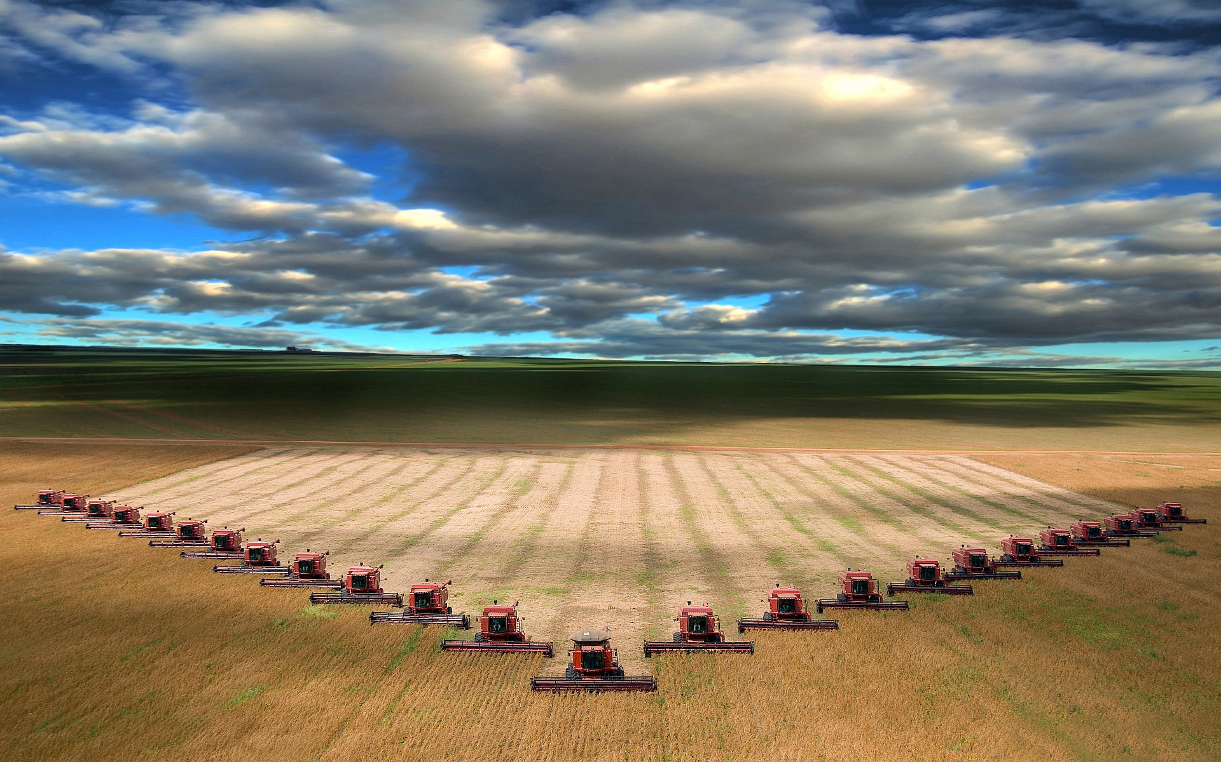

Slide 3
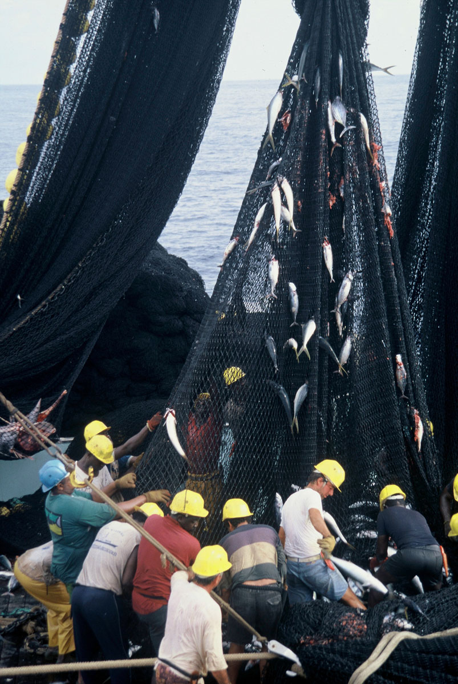
Notes:
Picture of Roraima state in Amazon

Slide 4
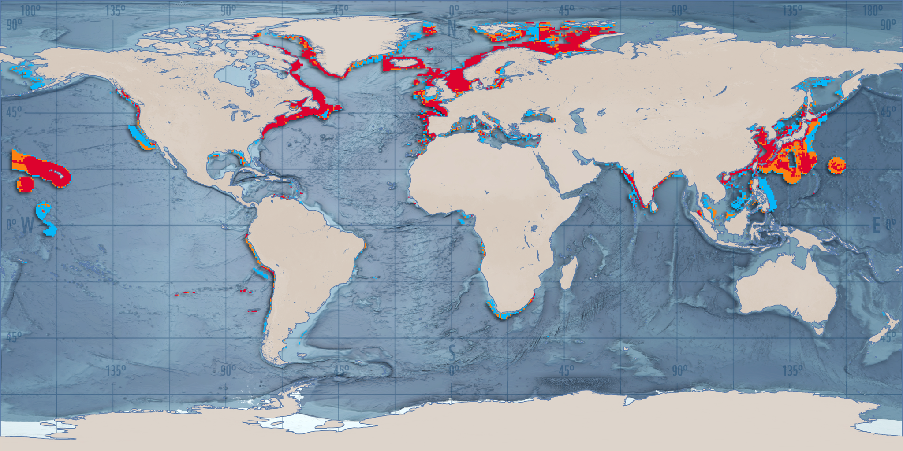
Overfishing
渔业过度捕捞
The expansion and impact of worldwide fishing fleets, 1950 & 2006
1950及2006年全球捕鱼船只规模以及影响
>30% Biomass Harvested
>30% 生物总量捕捞
1950
Source: WWF Netherlands (2011). Spatial Expansion of EU and Non-EU Fishing Fleets Into the Global Ocean, 1950 to the Present.
Notes:
Modeled after fishing fleet size data.

Slide 5
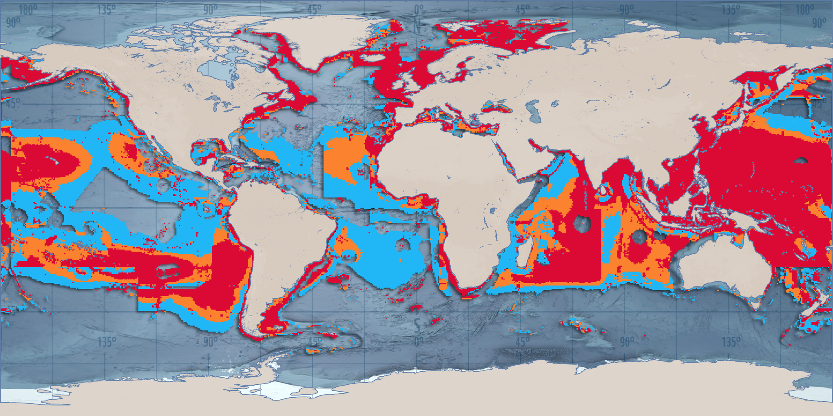
Overfishing
渔业过度捕捞
The expansion and impact of worldwide fishing fleets, 1950 & 2006
1950及2006年全球捕鱼船只规模以及影响
>30% Biomass Harvested
>30% 生物总量捕捞
2006
Source: WWF Netherlands (2011). Spatial Expansion of EU and Non-EU Fishing Fleets Into the Global Ocean, 1950 to the Present.
Notes:
Modeled after fishing fleet size data.

Slide 6
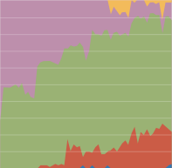
Overfishing
渔业过度捕捞
Trends in the state of global fishery stocks, 1950-2006
1950-2006年间全球渔业资源状态趋势
Rebuilding 恢复中
Developing 开发中
Exploited 完全捕捞
Overexploited 过度捕捞
Collapsed 渔源溃决
Source: UNEP Global Environmental Outlook 5 (2012)

Slide 7
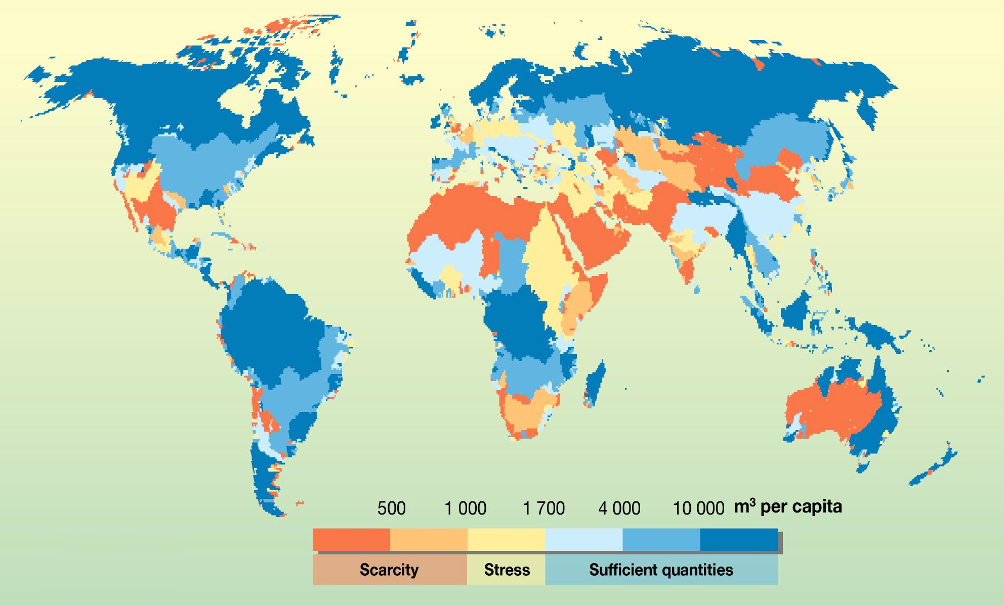
Water Stress
水资源压力
Projected water supply per river basin in 2025
2025年河川流域水资源供给预测
2025
Source: UNEP (2008). Vital Water Graphics - An Overview of the State of the World’s Fresh and Marine Waters.
Notes:
Based on waterGAP model. Water stress in river basins around the year 2000, as described by the ratio of annual water withdrawals to renewable water resources.

Slide 8
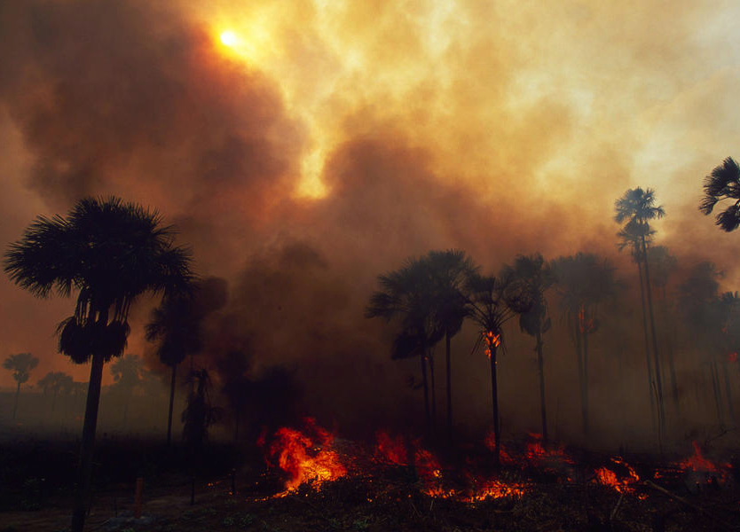
24%
of anthropogenic GHG emissions
come from deforestation and agriculture
的人为温室气体排放源自于伐林与农业活动
Forest on fire in Roraima state in Spring 1998 Amazon, Brazil.
Photo: © Nigel Dickinson / WWF-Canon
Source: IPCC AR5 “Climate Change 2014: Mitigation of Climate Change"
Notes:
Picture of Roraima state in Amazon

Slide 9
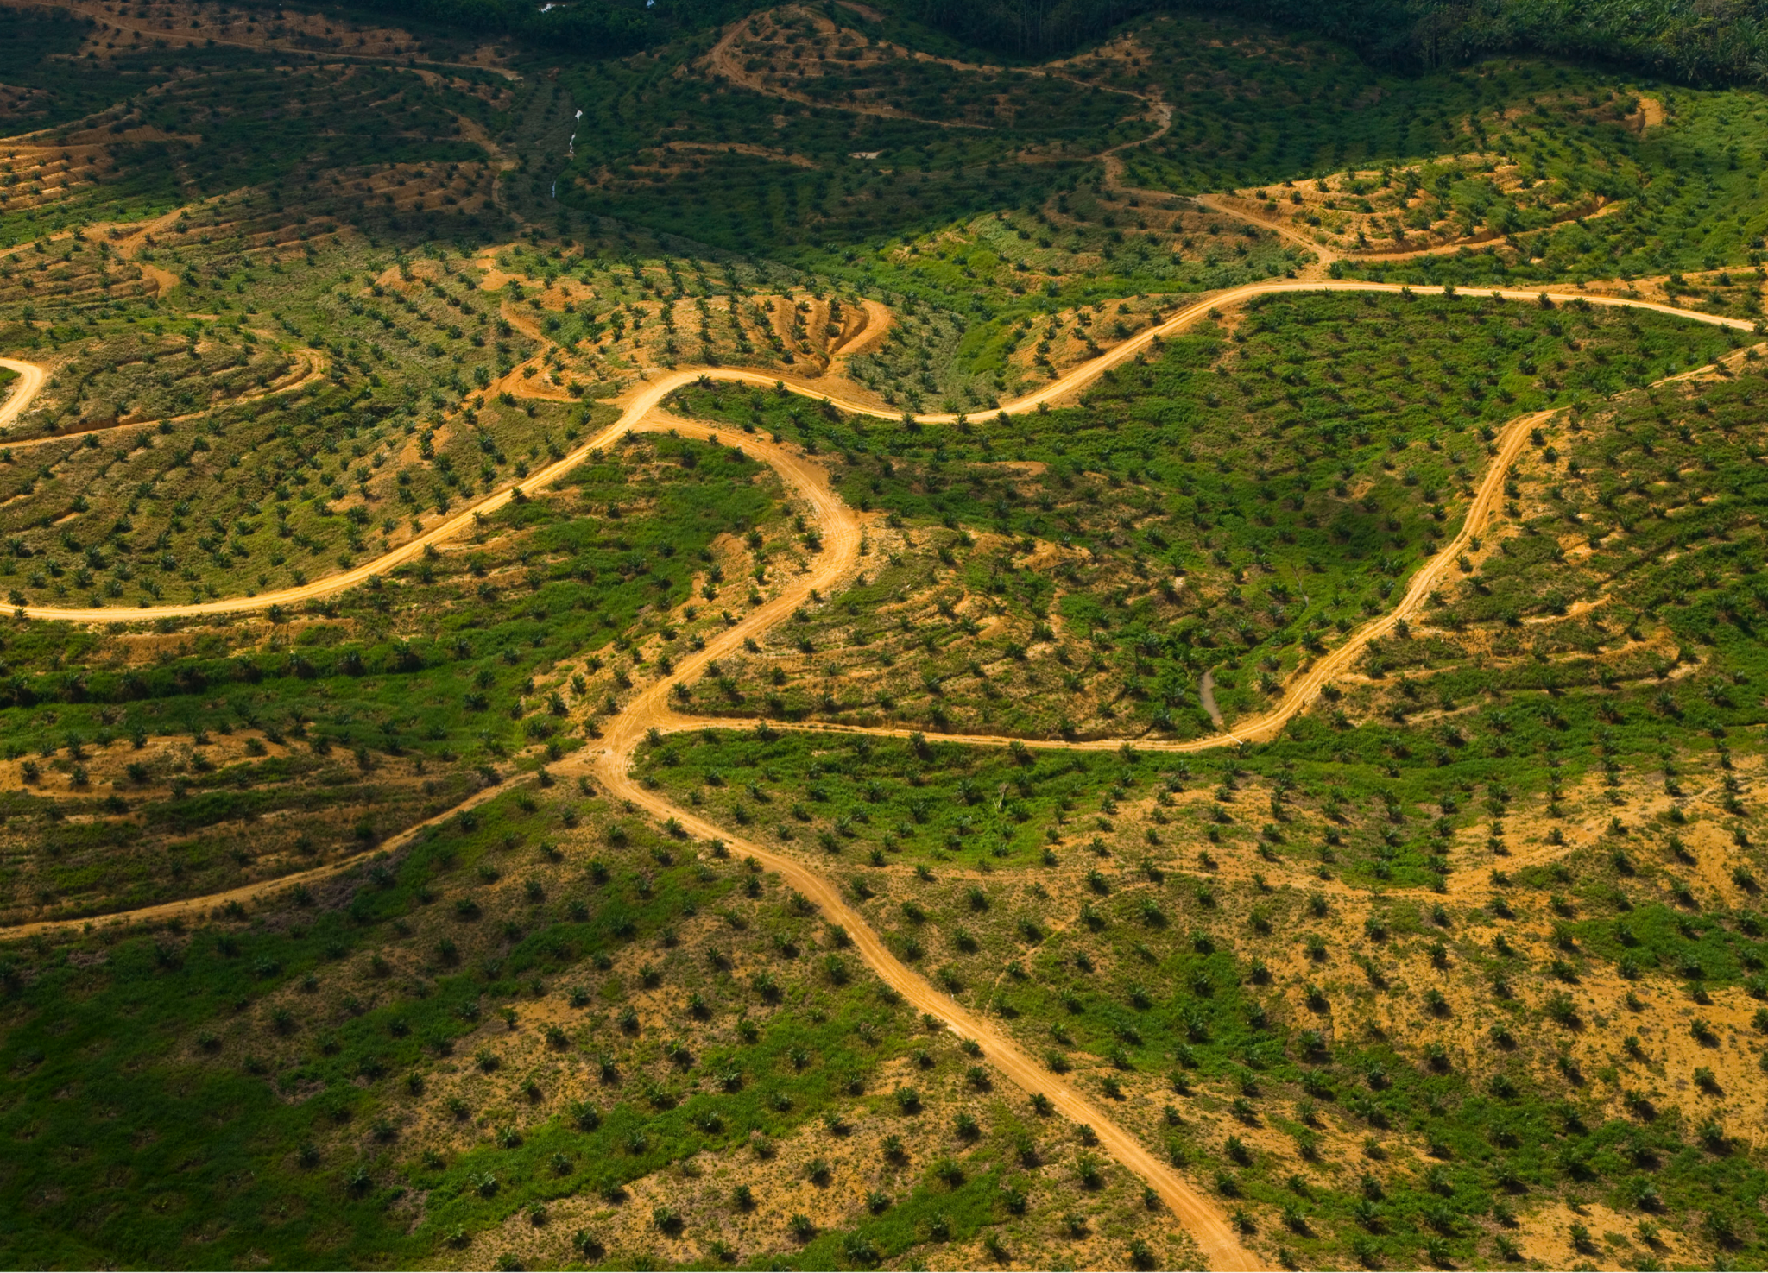
71%
of tropical and sub-tropical
deforestation comes from agriculture
的热带与副热带伐林来自农业开垦
Aerial view of palm oil plantation on deforested land in Sabah, Borneo, Malaysia.
Photo: © 2007 naturepl.com / Juan Carlos Munoz / WWF-Canon
Source: Forest Trends (2014). Consumer Goods and Deforestation: An Analysis of the Extent and Nature of Illegality in Forest Conversion for Agriculture and Timber Plantations.
Notes:
Picture of Sabah, Borneo, Malaysia

Slide 10
Illegal Deforestation
非法伐林
Proportion of global exports of select commodities originating from illegal forest conversion
全球初级产品生产来自违法林地变更之比例
Palm Oil
棕榈油
Tropical Timber
热带木材
Soy
大豆
Beef
牛肉
Source: Forest Trends (2014). Consumer Goods and Deforestation: An Analysis of the Extent and Nature of Illegality in Forest Conversion for Agriculture and Timber Plantations.

Slide 11
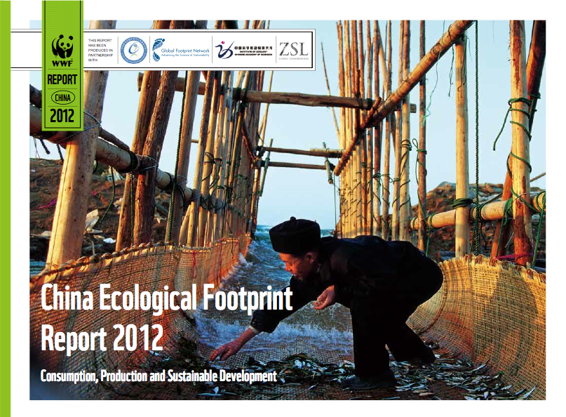
China’s Footprint
中国的影响

Slide 12
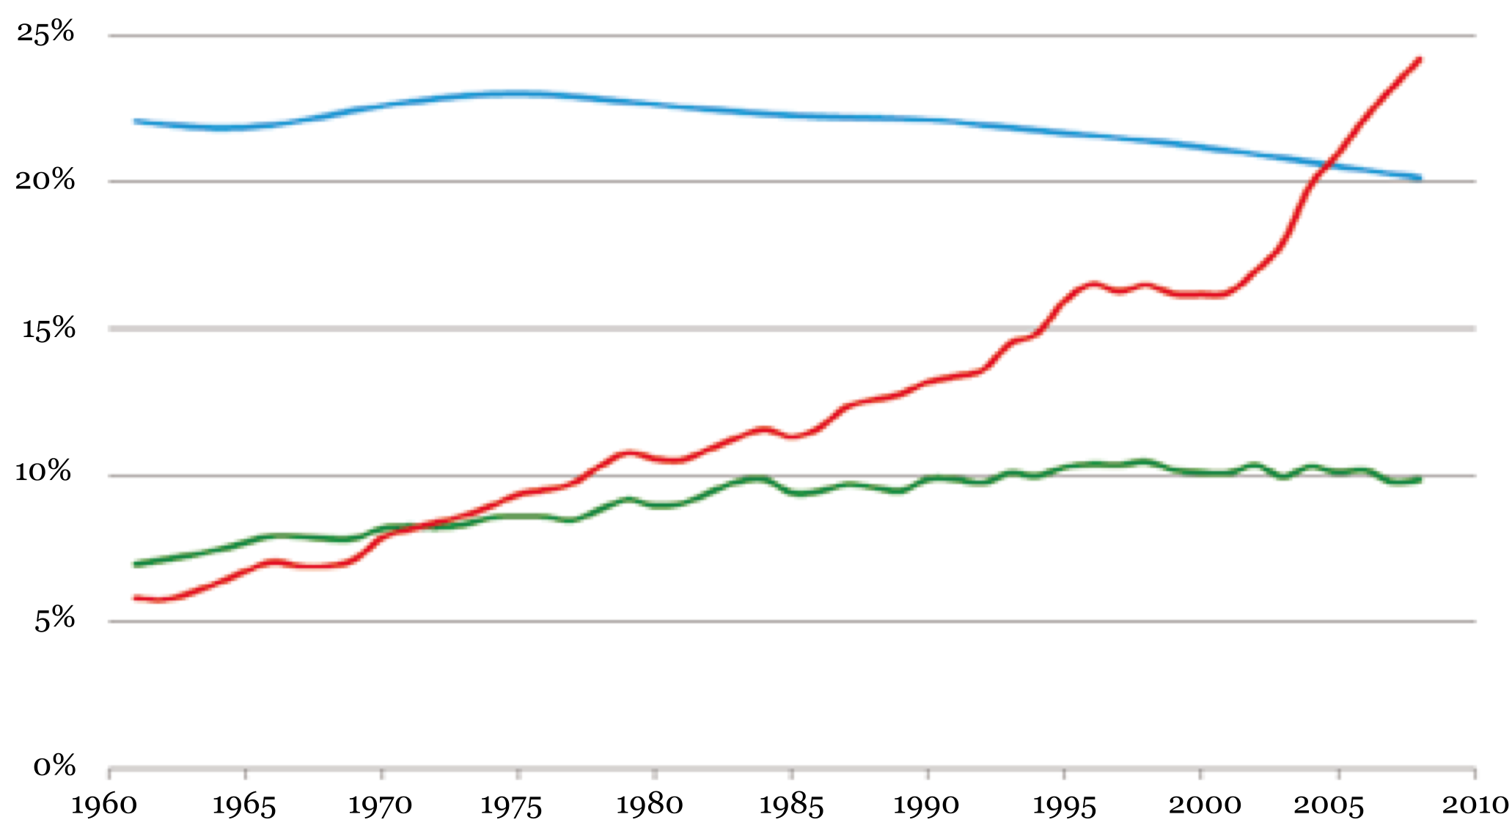
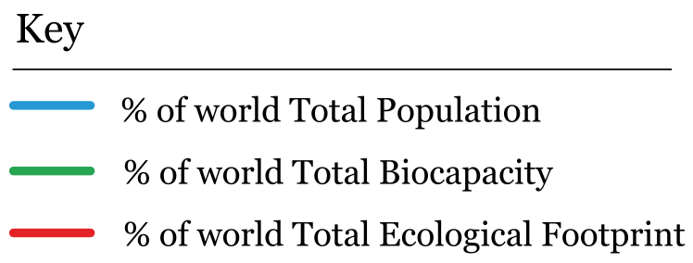
China’s Footprint
中国的影响
Global proportion of China’s footprint, 1961-2008
1961-2008年间中国生态足迹占国际比例
占世界人口百分比
占世界生態承載量百分比
占世界生態足跡百分比
Source: Global Footprint Network (2011)

Slide 13
Global Commodities Market
全球初级产品市场
Trends in the global and Chinese fisheries imports, 1976-2011
1976-2011年间全球及中国渔产进口量趋势
Fish
渔产
Global 全球
China 中国
12%
Source: FAO Fisheries & Aquaculture Department

Slide 14
Global Commodities Market
全球初级产品市场
Trends in the global and Chinese aquaculture production, 1976-2011
1976-2011年间全球及中国养殖水产生产量趋势
Aquaculture
养殖水产
Global 全球
60%
China 中国
Source: FAO Fisheries & Aquaculture Department

Slide 15
Global Commodities Market
全球初级产品市场
Trends in the global and Chinese palm oil imports, 1961-2011
1950-2006年间全球及中国棕榈油进口量趋势
Palm Oil
棕榈油
Global 全球
China 中国
16%
Source: FAOSTAT

Slide 16
Global Commodities Market
全球初级产品市场
Trends in the global and Chinese roundwood imports, 1961-2013
1961-2013年间全球及中国圆木进口量趋势
Roundwood
圆木
Global 全球
China 中国
35%
Source: FAOSTAT

Slide 17
Global Commodities Market
全球初级产品市场
Trends in the global and Chinese soy imports, 1961-2011
1950-2006年间全球及中国大豆进口量趋势
Soy
大豆
58%
Global 全球
China 中国
Source: FAOSTAT

Slide 18
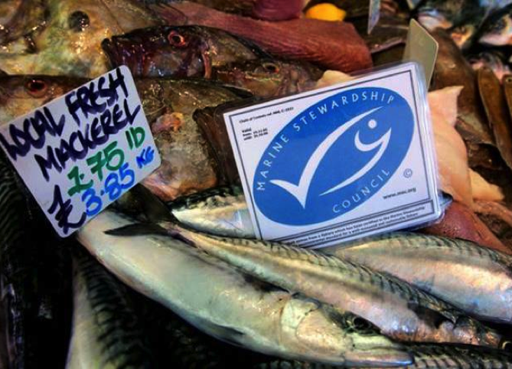
Photo: © WWF
Notes:
Picture of Roraima state in Amazon

Slide 19
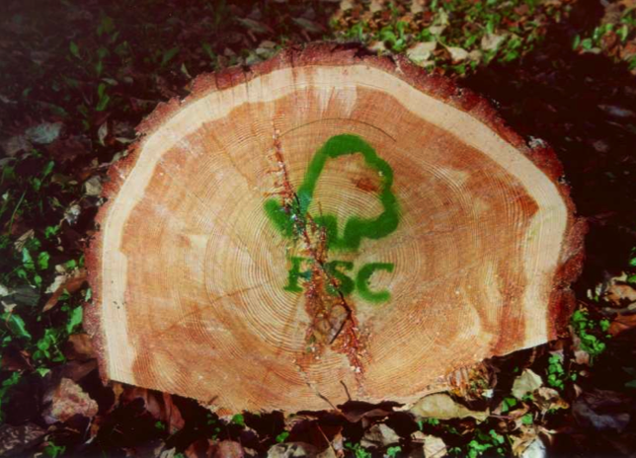
Photo: © WWF
Notes:
Picture of Roraima state in Amazon

Slide 20
Current Certification Landscape
当前认证标章市场占有率
17%
of total forested area
worldwide certified
全球森林面積
(2013)
10%
of global annual harvest of
wild capture fisheries
全球野生漁獲量
(2013)
16%
of worldwide annual
palm oil production
全球棕榈油年产量
(2014)
Source: RSPO, MSC Annual Report 2013-2014, FSC 2013 Annual Review

Slide 21
Key Players in Sustainable Commodities
可持续生产重要伙伴
Seafood
海产

Slide 22
Key Players in Sustainable Commodities
可持续生产重要伙伴
Soy
大豆
中国大豆产业协会
China Soybean
Industry Association

Slide 23
Key Players in Sustainable Palm Oil
当前可持续棕榈油生产重要伙伴
Palm Oil
棕榈油

Slide 24
Key Players in Sustainable Palm Oil
当前可持续棕榈油生产重要伙伴
60%
Zero Deforestation
Commitments
零伐林承诺
Photo: Martin H. / CC-BY-SA
Adopted across commodities in Dec. 2013. (45% market share)
新加坡丰益国际集团（市占约45%）于2013年十二月起停止全数初级产品伐林。
Adopted for palm oil production in 2011, applied to all third-party suppliers in Feb. 2014. (~5% market share)
印尼金光农业资源集团（市占约5%）于2011年停止棕榈油生产伐林。2013年二月扩及所有第三方供应商。
Adopted for palm oil production in Aug. 2014. (~10% market share)
美国嘉吉集团（市占约10%）于2014年八月起停止棕榈油生产伐林。
Source: 2014 UN Climate Summit. New York Declaration on Forests

Slide 25
Key Players in Sustainable Commodities
可持续生产重要伙伴
Finance
金融
Banking Environment Initiative
银行业环境倡议

Slide 26
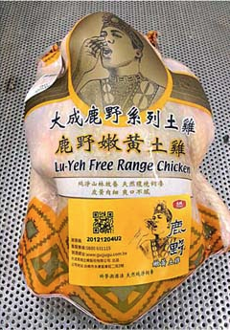
China’s Progress
当前中国国内发展趋势
Notes:
Label placement on product
Tracing number
QR code

Slide 27
FSC in China
森林管理委员会在中国
2007
Multi-stakeholder China FSC national FSC initiative established a
localized, but internationally recognized standard.
政府以及非政府组织共同组成FSC中国森林认证工作组，量身打造适
用于中国且符合国际标准的森林管理规范。
Sep. 2014
3.4 million hectares and 3,627 businesses in China certified.
中国超过340万公顷的森林以及3627家企业已经获得FSC认证。
国家林业局
State Forestry Administration
Vanke Group
Jilin Forestry Group
AnXin Floors
Notes:
Chinese Logos: Jilin Forestry Group, Wanke, Yihua Timber, An-Xin Floors.

Slide 28
Key Players in Sustainable Palm Oil
当前可持续棕榈油生产重要伙伴
“For Chinese enterprises involved with palm oil, the coming five years will be a critical period for the development of a robust sustainability approach that will offer better guarantees for the future stability of the palm oil sector and its contributions to food security, economic prosperity and global environmental improvement.”
「对于中国棕榈油企业来说，未来五年将是取得可持续发展重大成效的关键时期，这将为棕榈油行业未来的稳定发展、粮食安全、经济繁荣以及全球环境的改善提供更好地保障。若要实现该目标，企业就需要提高自身的经济实力。」
Source: CFNA (2012). Prospects and Challenges of Sustainable Palm Oil for China.

Slide 29
Recommendations for Action
未来行动建议
Government
政府部门
Issue a clear mandate
制定明确的规范
Use development assistance to build capacity
善用开发援助进行能力建设
Control illegal trade
控管非法贸易
Provide training
提供人力培训
Ensure transparency
确保制度透明化
Shift procurement
转换公部门采购
Create financial incentives
创造商业诱因
Start with pilot programs
由推动试点计划开始

Slide 30
Recommendations for Action
未来行动建议
Business
企业
NGOs
非政府组织
Keep it legal
遵守法律
Trade associations
商会组织
Get transparent
产销透明化
Other NGOs
其他非政府组织
Get certified
取得认证

