Slide 1
中国能源革命与应对气候变化对策
The energy revolution and strategy of addressing climate change in China
清华大学
Tsinghua University
He Jiankun
2014-12-03

Slide 2

1. 中国经济社会发展既面临日趋强化的资源环境制约，也面临应对气候变化减排CO₂的挑战，推动能源生产和消费革命，是两者统筹的战略选择和根本途径(1)
China's economic and social development is facing an increasingly restriction of resources and environment, is also facing the challenges of climate change and CO₂ mitigation, promoting energy production and consumption revolution are the strategic choice and fundamental way for both
快速增长的化石能源生产和消费是造成当前“资源约束趋紧、环境污染严重、生态系统退化”严峻形势的首要原因。
Rapid growth in production and consumption of fossil fuels is mainly causing the grim situation of current "tight resource constraints, serious environmental pollution and ecosystem degradation".
  SO₂、NO_{x}、烟尘等常规污染物排放的70%以上来自燃煤和汽车尾气。
  more than 70% of SO₂, NOx, soot and other conventional pollutants came from coal combustion and vehicle exhaust.
  北京PM_{2.5}，化石能源消费贡献率夏天约占50%，冬天约占70%；PM_{2.5}成分中，40-75%的重金属、超过50%的黑碳来自化石能源消费。
  In Beijing, around 50% of PM_{2.5} came from fossil fuel consumption in the summer, around70% of PM_{2.5} in the winter. In the component of PM_{2.5}, around 40-75% of the heavy metals and more than 50% of black carbon came from fossil fuel consumption.
  煤炭产量超过科学产能近一倍，造成土地塌陷100万ha，地下水资源污染严重。
  Coal production nearly doubled over the scientific capacity, resulting in land subsidence 1 million ha, serious pollution of groundwater resources.

Slide 3

1. 中国经济社会发展既面临日趋强化的资源环境制约，也面临应对气候变化减排CO₂的挑战，推动能源生产和消费革命，是两者统筹的战略选择和根本途径(2)
China's economic and social development is facing an increasingly restriction of resources and environment, is also facing the challenges of climate change and CO₂ mitigation, promoting energy production and consumption revolution are the strategic choice and fundamental way for both
石油、天然气进口依存度持续增加，能源安全面临新的挑战。
The import dependency of oil and gas continues to increase, energy security is facing new challenges.
  从2007-2012年，世界石油贸易量稳定在27亿吨，中国同期进口量从2.03亿吨增加到3.5亿吨，增长72%，同期美国石油进口量减少35%。我国2012年石油进口依存度已达58%，超过美国的42%。
  From 2007 to 2012, the world's oil trade stable at 2.7 billion tons. During this period, the imports oil of China increases from 203 million tones to 350 million tons, increases 72%; the imports oil of the U.S. decreases 35%. In 2012, China’s import dependency of oil reached to 58%, more than American’s 42%.

Slide 4

1. 中国经济社会发展既面临日趋强化的资源环境制约，也面临应对气候变化减排CO₂的挑战，推动能源生产和消费革命，是两者统筹的战略选择和根本途径(3)
China's economic and social development is facing an increasingly restriction of resources and environment, is also facing the challenges of climate change and CO₂ mitigation, promoting energy production and consumption revolution are the strategic choice and fundamental way for both
中国处于工业化快速发展阶段，减缓CO₂排放面临艰巨任务。
China is in rapid development stage of industrialization, faced with the daunting task of reducing CO₂ emissions.
  从1990-2013年，GDP增长9.3倍，人均GDP由370美元增加到6757美元，单位GDP能源强度下降59%，CO₂强度下降62%。经济发展和节能减排均取得显著成效。但同期能源消费总量增3.8倍，2005-2012年新增CO₂排放量约占世界增量的60%。
  From 1990 to 2013, China’s GDP has experienced a 9.3-fold increase; GDP per capita grew from 370 US dollars to 6,757 US dollars; energy intensity per GDP decreased by 59%; and carbon intensity per GDP has reduced by 62%. Much has been accomplished in both economic growth and energy saving and emissions reduction. During the same period time, the total amount of energy consumption increased by 3.8 times, the increased emissions from 2005 to 2012 made up for nearly 60% of the total increase all over the world。

Slide 5
1. 中国经济社会发展既面临日趋强化的资源环境制约，也面临应对气候变化减排CO₂的挑战，推动能源生产和消费革命，是两者统筹的战略选择和根本途径(4)
China's economic and social development is facing an increasingly restriction of resources and environment, is also facing the challenges of climate change and CO₂ mitigation, promoting energy production and consumption revolution are the strategic choice and fundamental way for both
  新能源和可再生能源发展速度和规模都居世界前列，但煤炭等化石能源仍快速增长，在一次能源中比例一直在70%左右，2012年煤炭消费36.5亿吨，约占全球45%，2005-2011年新增煤炭消费占世界增量的68%。石油消费增加量占世界增量的47%。
  The development speed and scale of new and renewable energy in China are ranked among the top of the world, but fossil energy such as coal still grows fast and has been always making up for around 70% of the primary energy. The coal consumption in 2012 was 3.65 billion tons, accounting for 45% of the world total. The increased coal and petroleum consumed from 2005 to 2012 accounted for 68% and 47% of the world respectively.
全球资源环境制约日益强化，发展中国家不可能再沿袭发达国家以高资源消费和高排放为支撑的传统现代化道路，必须走以技术创新为支撑的新型工业化和城市化道路，走绿色低碳的发展路径。
The tightening constraint of global resources has prevented the developing countries from repeating the traditional patterns of development which are at the expenses of high resource consuming and high emissions. Thus, it is essential for China to choose a low-carbon approach supported by technology innovation in its processes of industrialization and urbanization.
推动能源生产和消费革命，是统筹国内可持续发展和全球应对气候变化“双赢”的战略选择，具有目标的一致性和协同效应。
Promoting energy production and consumption revolution is the win-win strategies of coordinating domestic sustainable development and addressing global climate change, and has the consistency and co-benefit.

Slide 6

2. 强化节能和能源低碳化转型是中国能源革命的核心，大幅度降低单位GDP的能源强度和CO₂强度是统筹经济增长和节能减碳的综合目标和关键着力点(1)
Strengthening energy saving and low carbon energy transformation is the core of China's energy revolution, greatly reducing energy intensity and CO₂ intensity per GDP is synthetical target for economic growth and the energy saving as well as carbon reduction.
“十一五”制定GDP能源强度下降20%左右的约束性目标，实际达到19.1%，相应CO₂强度下降21%。
In“11th Five Year Plan” the government establish the legally binding targets for reducing energy intensity per GDP by around 20%, the actually achievement is 19.1%, and the relative CO₂ intensity per GDP decrease 21%.
“十二五”制定GDP能源强度下降16%、CO₂强度下降17%的约束性目标。
In “12th Five Year Plan” the government establish the legally binding targets for reducing energy intensity per GDP by 16% and reducing CO₂ intensity per GDP by 17%.
从2005-2013年，GDP的CO₂强度已下降28.5%，同期附件I国家下降幅度不到15%。
From 2005 to 2013, China’s CO₂ intensity per GDP had decreased 28.5%, at the same period the descend range of Annex I is no more than 15%.
中国制定2020年单位GDP的CO₂强度比2005年下降40-45%的目标，“十三五”经努力有望超过45%。
China set the target of reducing CO₂ intensity per GDP around 40% to 50% in 2020 than 2005, in “13th Five Year Plan” the goal of 45% probability be exceeded by effort.

Slide 7
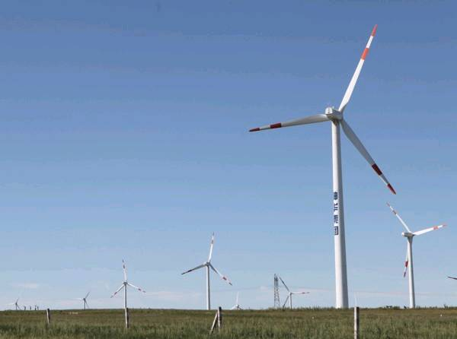
2. 强化节能和能源低碳化转型是中国能源革命的核心，大幅度降低单位GDP的能源强度和CO₂强度是统筹经济增长和节能减碳的综合目标和关键着力点(2)
Strengthening energy saving and low carbon energy transformation is the core of China's energy revolution, greatly reducing energy intensity and CO₂ intensity per GDP is synthetical target for economic growth and the energy saving as well as carbon reduction.
中国同时制定2020年非化石能源比例从2005年6.8%上升到15%的目标。
China establish the target of increasing percentage of non-fossil fuel from 6.8% in 2005 to 15% in 2020.
中国可再生能源发展迅速，投资规模、新增容量和增长速度均居世界第一。2013年水电、上网风电、上网光伏发电容量分别达2.8亿千瓦、7548万千瓦、1480万千瓦，均达世界前列。核电在建规模3723万千瓦，约为世界40%。
China has experienced fast development in the field of renewable energy and has ranked first in terms of investment scale, the added installed capacity and growth rate. The generation capacities of hydro power, grid-connected wind power and grid-connected photovoltaic power reached 280 GW, 75.5GW and 14.8GW in 2013, all among the first ranks in the world. The scale of nuclear power in process is 37.23GW, accounting for nearly 40% of the world total.
2013年非化石能源比例达9.8%，今后每年供应量增速要达8-10%。
In 2013 China’s percentage of non-fossil fuel is 9.8%, and its annual growth of supply will be 8% to 10% in the future.
2020年非化石能源供应量将达7亿tce，相当日本能源消费总量。
In 2020 China’s non-fossil fuel supply will be 700 million tce, is the equal of Japan’s total energy consumption.

Slide 8

2. 强化节能和能源低碳化转型是中国能源革命的核心，大幅度降低单位GDP的能源强度和CO₂强度是统筹经济增长和节能减碳的综合目标和关键着力点(3)
Strengthening energy saving and low carbon energy transformation is the core of China's energy revolution, greatly reducing energy intensity and CO₂ intensity per GDP is synthetical target for economic growth and the energy saving as well as carbon reduction.
中国确立2030年非化石能源比重达20%左右目标，需要做出巨大努力。
China establish the target of increasing percentage of non-fossil fuel to around 20% in 2030, and this goal need to be made by great efforts.
  2030年非化石能源供应量约为12亿tce，是2010年2.68亿tce的4.5倍。
  In 2030 the supply of non-fossil fuel will be around 1.2 billion tce, is about 4.5 times than 2010 (268 million tce).
从目前到2030年，新增核电、水电、风电、光伏发电、生物质发电等非化石能源装机8-10亿千瓦，非化石能源领域新增投资约达8万亿元。
From now to 2030, the new increasing new and renewable energy power generation capacity including nuclear power, hydroelectric, wind power, PV power, biomass power will be around 800-1000GW, and the new investment of non-fossil power will be around 8 trillion Yuan.
新能源和可再生能源产业将面临快速发展的局面。
The industry of new and renewable energy will face the situation of rapid development.

Slide 9
3. “十三五”及以后中国在进一步强化单位GDP的能源强度和CO₂强度下降目标的同时，将探讨能源消费总量的控制目标(1)
From “13th Five Year Plan” China not only further strengthen energy intensity per GDP and CO₂ intensity per GDP, but also focus on researching control target of total energy consumption.
习近平主席提出：要推动能源消费革命，抑制不合理能源需求，坚决控制能源消费总量。并将其作为促进经济发展方式转变和环境治理的重要政策。
President Xi Jinping: To promote energy consumption revolution, curb unreasonable energy demand, firmly control the total energy consumption. And it is a significant policies to promote the transformation of economic development patterns and environment governance.
  “十三五”及以后，技术节能难度加大，成本增加，但产业结构调整和升级带来的结构性节能效果将更加显现。能源消费弹性可比“十二五”进一步下降，加上能源结构改善的效果，单位GDP的CO₂强度下降幅度应与“十二五”相当。
  In “13th Five Year Plan” and after, technical energy–saving will become difficult and its cost will increase. But the energy-saving from adjustment and upgrading of industrial structure will become more obvious. The elasticity of energy consumption in “13th Five Year Plan” will decrease compared with “12th Five Year Plan”, with improvement of energy structure, the declines of CO₂ intensity per GDP in “13th Five Year Plan” will be close to in “12th Five Year Plan”.
  “十三五”应实施能源消费总量（主要是煤炭）和CO₂排放总量的控制目标，实施“强度”和“总量”的双控机制。2020年能源消费总量可控制在约48亿tce。
  In “13th Five Year Plan” the government need to implement the control target of total energy consumption (mainly coal) and total CO₂ emissions, and to implement control mechanism both “intensity” and “total quantity”. In 2020 China’s total energy consumption probability be controlled within 4.8 billion tce.

Slide 10
4. 研究和确立CO₂排放峰值目标，建立目标责任制，形成转变发展方式的“倒逼”机制(1)
To research and establish the target of CO₂ emissions peak, to establish the target duty system, and to form new mechanism to promote transform of development patterns.
研究并借鉴发达国家CO₂排放达峰值规律，探索更为低碳的发展目标和路径。
To research and learn CO₂ emission peak regularity from developed countries, and to explore the goal and path of low-carbon development.
  欧、美等发达国家人均CO₂排放峰值和总量峰值时间都陆续出现在1970年代初完成工业化和城市化发展阶段之后。人均GDP（2000年不变价）超过10000美元。
  In developed countries such as Europe and Americas, the capita CO₂ emissions peak and total CO₂ emissions peak appeared from the 1970s when their industrialization and urbanization were realized. The capita GDP (in constant 2000 prices) is more than $10,000.
  能源消费量峰值时间滞后于CO₂排放峰值时间，欧盟CO₂排放峰值（1980年）比能源消费峰值（2005年）早25年。
  Energy consumption peak time is behind the CO₂ emission peak time. For example, in Europe Union, CO₂ emissions peak time(1980) is earlier than its energy consumption peak time(2005) by 25 years.
  工业部门的CO₂排放峰值早于全国CO₂排放总量峰值。
  CO₂ emissions peak time in industry sector is earlier than national CO₂ emissions peak time.
  不同发达国家人均CO₂排放峰值量有较大差别。欧盟9.4t/人，日本9.5t/人，比美国22.2t/人低一半以上。
  Capita CO₂ emissions in developed countries are great deferent. EU 9.4 t/person, Japan 9.5 t/person, and US 22.2 t/person.
中国发挥后发优势，实现峰值的时间可早于发达国家峰值时的发展阶段，人均CO₂排放峰值水平也应更低。
China has significant backwardness advantage, its CO₂ emissions peak time probability be earlier than developed countries’ development stage, and its capita CO₂ emission probability be lower than developed countries.

Slide 11

4. 研究和确立CO₂排放峰值目标，建立目标责任制，形成转变发展方式的“倒逼”机制(2)
To research and establish the target of CO₂ emissions peak, to establish the target duty system, and to form new mechanism to promote transform of development patterns.
CO₂排放达峰值必要条件：
Prerequisites of CO₂ emission peak：
    ①GDP碳强度年下降率（碳生产率年提高率）≥GDP年增长率；
    Annual decrease rate of carbon intensity per GDP (annual increase rate of carbon productivity) ≥ annual growth rate of GDP
    其中：GDP的CO₂强度下降率≈GDP能源强度年下降率+单位能耗CO₂强度年下降率:
    Note: Annual decrease rate of CO₂ intensity per GDP ≈ Annual decrease rate of energy intensity per GDP + Annual decrease rate of CO₂ intensity per energy consumption.
    ②单位能耗CO₂强度年下降率≥能源消费年增长率。
    Annual decrease rate of CO₂ intensity per unit of energy consumption ≥ annual increase rate of energy consumption
  全面分析我国未来GDP潜在增速、节能潜力与效果、新能源和可再生能源发展趋势和相关指标，根据上述必要条件分析，分析峰值年份与峰值排放量的控制目标。
  Analyze comprehensively China‘s potential GDP growth, energy-saving potential and effects, new and renewable energy development trends and relative indicators in the future, based on the above necessary conditions analysis, to research the target of the peak year and peak emissions.
  峰值目标不是预测，而是分析经努力可能实现的积极目标，设计排放路径，落实保障措施，形成“倒逼”机制。
  Peak target does not the forecast. It analyzes possibility achieved active target by effort, designs emissions path, develops safeguard mechanism, and forms new mechanism.

Slide 12

4. 研究和确立CO₂排放峰值目标，建立目标责任制，形成转变发展方式的“倒逼”机制(3)
To research and establish the target of CO₂ emissions peak, to establish the target duty system, and to form new mechanism to promote transform of development patterns.
2030年前后CO₂排放达峰值的可能性分析。
Possibility analysis of CO₂ emissions peak around 2030.
①GDP的CO₂强度下降率>GDP年增长率
  Annual decrease rate of the CO₂ intensity per GDP > annual growth rate of GDP
  2030年左右，GDP能源强度下降不低于3%，能源消费的CO₂强度下降率不低于1.5%，GDP的CO₂强度下降率约4.5%，支持GDP年均4～5%的速度增长。
  With an GDP growth rate of 4-5% in around 2030, China’s decrease rate of energy intensity per GDP will need to be no lower than 3%, the decrease rate of CO₂ intensity per energy consumption no lower than 1.5%, and the decrease rate of CO₂ intensity per GDP approximately 4.5%.
②单位能耗的CO₂强度年下降率>能源消费年增长率
Annual decrease rate of CO₂ intensity per energy consumption > Annual growth rate of energy consumption.
  2030年左右，非化石能源比重约达20%，且以年均6～8%的速度增长，单位能耗的CO₂强度下降率可达1.5% ，可支持总能源需求1.5%的增长。在能源消费弹性约0.3～0.4情况下，支持GDP年均4～5%的增速。
  With an energy consumption growth rate of 1.5% in around 2030, China’s share of non-fossil energy will need to be around 20% with non-fossil energy supply growth keeping 6-8% per year, and the decrease rate of CO₂ intensity per energy consumption no lower than 1.5%. With an GDP growth rate of 4-5% in around 2030, China’s energy elasticity will need to be 0.3-0.4.

Slide 13
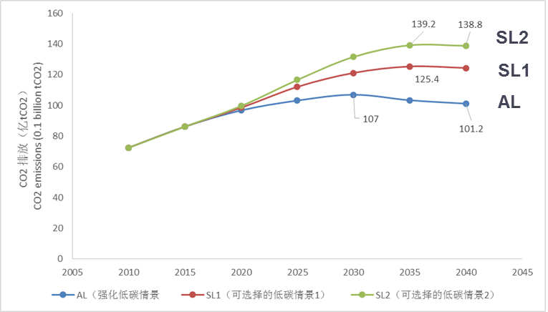
4. 研究和确立CO₂排放峰值目标，建立目标责任制，形成转变发展方式的“倒逼”机制(4)
To research and establish the target of CO₂ emissions peak, to establish the target duty system, and to form new mechanism to promote transform of development patterns.
          2030年前后CO₂排放达峰值的不确定性分析：
          Uncertainty analysis of CO₂ emissions peak around 2030 in China.
如果能源结构调整在达不到预期，特别是核能和天然气增长迟缓，则CO₂排放峰值还会滞后，峰值排放量还会增加。
If the energy switching could not take place as expected particularly due the slow growth of nuclear and natural gas supply, the CO₂ emissions peak time will be delayed and the peak volume will be increased.
AL: 强化低碳情景
Accelerated Low-carbon development scenario
SL1：可选择的低碳情景（1）
Selectable Low-carbon development scenario(1)
  GDP年均增长率比AL高出0.5个百分点。CO₂峰值约2035年。
  The annual growth rate of GDP in SL1 is 0.5% higher than in AL. The CO₂ emissions would peak in around 2035.
SL2：可选择的低碳情景（2）
Selectable Low-carbon development scenario (2)
  GDP年均增长率比AL高约0.5个百分点，GDP能源强度下降幅度5年减少约一个百分点，CO₂峰值推迟到2035年之后。
  Relative to AL, the annual increase rate of GDP is supposed to be 0.5% higher and the decrease rate of the energy intensity lower 1% on average in five year term in SL2. The CO₂ emission would peak later than 2035.

Slide 14
5. 我国工业化、城市化进程要走上绿色低碳发展路径，首先要促进产业转型，工业部门的能源消费和CO₂排放要率先达到峰值(1)
To achieve the goal of green and low-carbon industrialization and urbanization, the first step is to promote the industry transform and to advance the peak of energy consumption and CO₂ emissions from the industries.
发达国家上世纪70年代工业化后，总能耗基本趋于稳定。OECD的34个国家从1973-2009年，工业终端能耗下降23.5%，交通终端能耗增加68.6%，民用、商业能耗增加36.9%。
Ever since the accomplishment of industrialization of developed countries after 1970s, the total energy consumption has remained steady. From 1973 to 2009, 34 countries in OECD have experienced a decrease of 23.5% in industrial energy consumption, an increase of 68.6% in transportation energy consumption and an increase of 36.9% in residential and commercial energy consumption.
中国工业部门能耗占全国终端总能耗约70%（发达国家一般占1/3)，其中高耗能原材料产业占50%。高耗能产品需求即将陆续出现饱和。
Industrial energy use contributes around 70% to China’s total energy consumption (about 1/3 in developed countries). 50% of the consumption is from energy intensive and raw material industries. The demand of energy intensive products is approaching saturation.

Slide 15
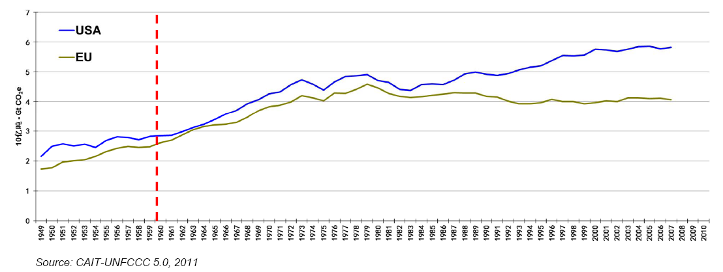
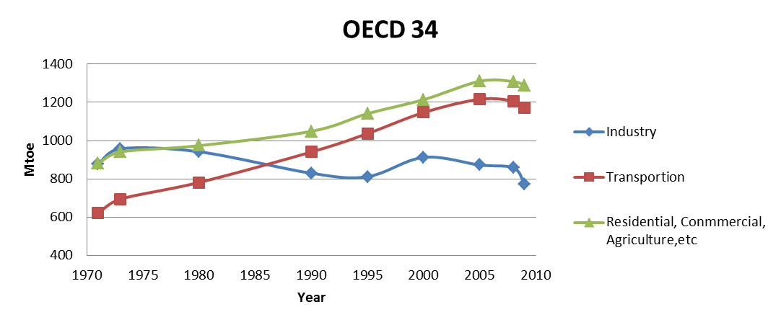
5. 我国工业化、城市化进程要走上绿色低碳发展路径，首先要促进产业转型，工业部门的能源消费和CO₂排放要率先达到峰值(2)
To achieve the goal of green and low-carbon industrialization and urbanization, the first step is to promote the industry transform and to advance the peak of energy consumption and CO₂ emissions from the industries.
实现CO₂排放峰值，必须工业部门能耗持续下降，交通、建筑能耗的增加依靠发展新能源和可再生能源满足，化石能源消费和CO₂排放趋于稳定并逐步下降。
To achieve the peak of CO₂ emissions, the industrial energy use should be decreased continuously. The increasing energy demand from transportation and buildings should be supplied by developing new and renewable energy; fossil energy consumption and CO₂ emissions are to be maintained steady and decreasing gradually.

Slide 16

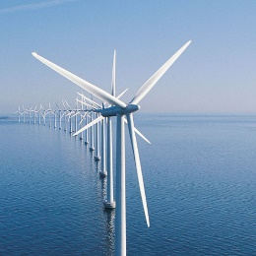
6.东部沿海发达地区要制定更为积极的低碳发展目标，在全国率先实现煤炭消费和CO₂排放峰值(1)
The developed eastern coastal areas should make more aspiring low-carbon goals to lead China in reaching the CO₂ emissions peak
东部发达地区人均GDP大都达10000美元左右，人均CO₂排放已相当或超过欧盟、日本人均CO₂排放峰值时水平。
The average income per capita in eastern developed areas in China is around 10,000 US dollars. The per capita CO₂ emission in above areas has already surpassed the per capita CO₂ emissions peaks of EU and Japan.
东部发达地区是能源资源短缺、环境污染严重地区，今年元月严重雾霾天气，燃煤排放是其首要成因。要实现煤炭消费和CO₂排放总量控制。
Eastern developed areas are short of energy resource and are facing serious pollution issues. The foggy and hazy weather in January this year was resulted primarily from coal combustion. The control over total coal consumption and CO₂ emissions should be enhanced.

Slide 17

6.东部沿海发达地区要制定更为积极的低碳发展目标，在全国率先实现煤炭消费和CO₂排放峰值(2)
The developed eastern coastal areas should make more aspiring low-carbon goals to lead China in reaching the CO₂ emissions peak
如仍持续当前发展模式，2020年很多地区的人均CO₂排放将远超欧盟、日本的水平，而直逼美国的人均水平。
If China continues to follow the current development pattern, the CO₂ emission per capita will far surpass the levels of EU and Japan and will reach that of the US.
北京市煤炭消费2005年已达到峰值，2011年已下降23%，人均CO₂排放2007年已到达峰值。
Beijing reached the coal consumption peak in 2005 and experienced a decrease of 23% in 2011. The CO₂ emissions per capita reached the peak in 2007.

Slide 18

7. 推动能源生产和消费革命的战略核心是建立高效、安全、清洁、低碳的可持续能源体系，需要前瞻性战略部署(1)
To promote energy production and consumption revolution, the core strategy is to build sustainable energy system with the character of efficient, secure, clean and low-carbon, need the prospective strategy
能源战略要从传统保障供给转变到同时调控需求，控制能源需求总量的过快增长，促进发展方式的转变。强化节能优先，大幅度提高能效。
The traditional energy strategy needs to be shifted from ensuring the supply to coordinating energy supply and demand with an emphasis on controlling the over-speeded growth of the total energy consumption, promoting the transformation of China’s development pattern. Enhancing energy saving and raising energy efficiency should be given priorities.
能源结构低碳化，实现大比例可再生能源目标。
Substantial efforts need to be taken to decarbonize the energy supply mix, realize the target of large proportion of renewable energies.
  非化石能源比重，2020年将达15%，2030年将超过20%，2050年将达1/3-1/2。
  The proportion of non-fossil energies will be 15% in 2020, more than 20% in 2030 and 33% to 50% in 2050.
加强煤炭清洁高效利用技术的研发和推广。
To strengthen the R&D and promotion of coal clean and high efficient utilization.

Slide 19
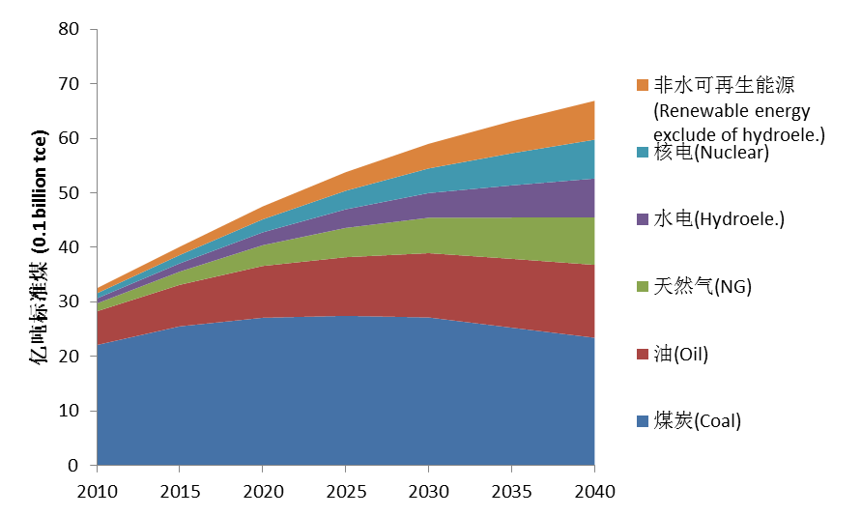
7. 推动能源生产和消费革命的战略核心是建立高效、安全、清洁、低碳的可持续能源体系，需要前瞻性战略部署(2)
To promote energy production and consumption revolution, the core strategy is to build sustainable energy system with the character of efficient, secure, clean and low-carbon, need the prospective strategy
在确保安全的基础上，稳步、高效发展核能。
Nuclear energy should be promoted stably and effectively on the basis of safety.
  核能将是我国未来可持续能源体系中的重要支柱，核能2030年装机达约1.5亿千瓦，到2050年可达3.5～4.5亿千瓦，将对我国CO₂排放达到峰值起关键作用。
  Nuclear energy will be a pillar industry in China’s sustainable energy system in the future. The installed capacity of nuclear energy will be about 150 million kW in 2030, and rise to 350~450 million kW by 2050, and will play significant role in reaching CO₂ emission peak.
加强国内能源资源的开发和科学高效利用，减少对外依赖，加强国际能源合作，保障能源供给安全。
Promoting the sustainable and efficient use of domestic energy resources, strengthening international energy cooperation, and ensuring energy supply security.
  加强常规和非常规天然气的勘探开发，天然气在一次能源比例迅速提升。
  To enhance the exploitation and development of conventional and unconventional natural gas to fast raise the natural gas proportion in primary energy supply.

Slide 20

8. 加强经济、能源、环境和应对气候变化的协同治理，实现多方共赢的发展目标
To strengthen the cooperative governance among the economy, energy, environment and addressing climate change, and to achieve win-win for more parties.
仅靠末端治理技术难以从根本上转变环境质量，东部沿海地区治理雾霾需要控制和减少煤炭消费量，有利于尽快实现CO₂排放峰值。
It is hard to improve environmental quality by only using terminal management technology. Governing haze in eastern coastal regions of China need to control and reduce coal consumption, and that will be helpful to implement CO₂ emissions peak as soon as possible.
应对气候变化下能源革命有利于促进经济发展方式的低碳转型，创造新的经济增长点和新的发展机遇，走上可持续发展的路径。
Under the situation of addressing climate change, energy revolution will promote economic pattern transformation to low carbon, will create new economic growth point and new development opportunities, and will achieve sustainable development.

Slide 21

9.明确低碳发展在国家和地区总体发展战略中的定位，加强制度和政策保障体系的建设(1)
To clearly locate low-carbon development in the overall strategy plan of the country and different regions, and to strengthen the establishment of related regulations and policy guarantee system
生态文明建设在“五位一体”的总体布局中占据突出地位，低碳发展在国家总体发展战略中应具有优先权重。强化对各级政府节能降碳的目标分解和责任考核。
Ecology protection plays a key role in “Five-in-One” plan and low-carbon development should be given priority in the nation’s overall development strategy. The central government should intensify the target duty of energy-saving and reducing carbon to all levels of government.
加快《应对气候变化法》和《低碳发展促进法》的立法进程，为低碳发展提供法律和政策保障。
To accelerate the establishment of Climate Change Law and Low-carbon Development Promotion Law to provide legislations and policy guarantees for low-carbon development.

Slide 22

9.明确低碳发展在国家和地区总体发展战略中的定位加强制度和政策保障体系的建设(2)
To clearly locate low-carbon development in the overall strategy plan of the country and different regions, and to strengthen the establishment of related regulations and policy guarantee system
加强财税金融政策体系和低碳消费激励机制的建设，建立并完善碳排放权交易等市场机制，为低碳发展创造良好的制度环境、政策环境和市场环境。
To create a favorable regulation, policy and market environment through enhancing the establishment of financial and tax policy system, low-carbon incentive system, and through establishing and improving the emissions trading schemes.
发挥碳排放空间的紧缺资源和生产要素的属性，改革能源价格机制，推进碳排放额度交易市场建设。
Reform of energy pricing mechanism and promotion of carbon market according to the property of carbon space as a scarce resource and a production factor.
  碳税和碳市场等“碳价”机制，引导先进能源技术创新和社会投资导向，促进能源体系变革和低碳发展。
  Introduction of carbon tax and carbon market as "carbon pricing" mechanism to guide advanced energy technology innovation and social capital investment as well as promote the energy system revolution and low carbon development.

Slide 23
10. 全球应对气候变化国际制度框架要促进各国的可持续发展，促进国际技术合作和互利共赢(1)
International framework on climate change should promote the sustainable development of the countries and facilitate the win-win technology collaborations.
促进能源体系变革，减少CO₂排放，具有经济、社会、环境多重效益，既是应对气候变化的核心对策，也是各国实现可持续发展的根本途径，存在合作共赢的空间。
Energy system reform and CO₂ emissions reduction will bring economic, social and environmental benefits. It is a core strategy in addressing climate change, a radical approach to achieving sustainable development of the countries and it creates win-win space for the countries.
先进能源技术发展带来的减排作用的价值，提高了先进技术的经济效益和推广速度，也增大了国际技术合作和技术转移的空间和潜力。
The development and deployment of advanced energy technologies create great value in emissions reduction, increase the economic growth and expansion pace and enhance the potential of international technology cooperation and transfer.
充分发挥碳价的作用，促进UNFCCC框架下技术转让，有利于促进发展中国家的可持续发展，同时给发达国家企业带来更广泛的市场和商机，其获得减排信用也可带来可观的经济收益。
Giving full play to the role of the carbon pricing, and promoting technology transfer under UNFCCC framework creates favorable conditions for sustainable development in developing countries and brings wide market and opportunities for the enterprises in developed countries. The emissions reduction credits generated will also bring developed countries considerable economic revenues.

Slide 24


10. 全球应对气候变化国际制度框架要促进各国的可持续发展，促进国际技术合作和互利共赢(2)
International framework on climate change should promote the sustainable development of the countries and facilitate the win-win technology collaborations.
全球应对气候变化下的能源变革要成为各国可持续发展的机遇，注重发挥减排CO₂与国内缓解资源环境压力的协同效应，促进各国自觉行动，不是“要我减”，而是“我要减”。
Under the situation of addressing global climate change, energy transform become a national sustainable development opportunities. The countries should pay attention to co-benefits of CO₂ emissions reduction with domestic resources and environment protection, promote the nations conscious action, instead of “Want me to reduce” there is “I want to reduce”.
全球应对气候变化国际制度不仅着眼于减排责任和义务的分担，更应着重于发展机遇的共享，着重于形成促进世界范围内经济社会发展方式向绿色低碳转型，转变经济增长方式和社会消费方式，促进能源变革，大幅度提高“碳生产率”的制度和机制，使世界各国都实现可持续发展与CO₂减排的双重目标和共赢路径。
International system of addressing global climate change is not only focusing on the sharing of emission reduction responsibilities and obligations, but also should focus on sharing development opportunities, on promoting the worldwide economy and society to green and low carbon, transferring the pattern of economic growth and social consumption, promoting energy revolution, setting up mechanism of increasing ‘carbon productivity’ substantially, so as to accomplish the dual target of sustainable development and CO₂ emission reduction worldwide.

Slide 25

Thank you!

