Slide 1
Engaging People in Green Growth
Experience from OECD Countries
Simon Upton, Director
Environment Directorate, OECD
Beijing, 13-15 November 2013

Slide 2
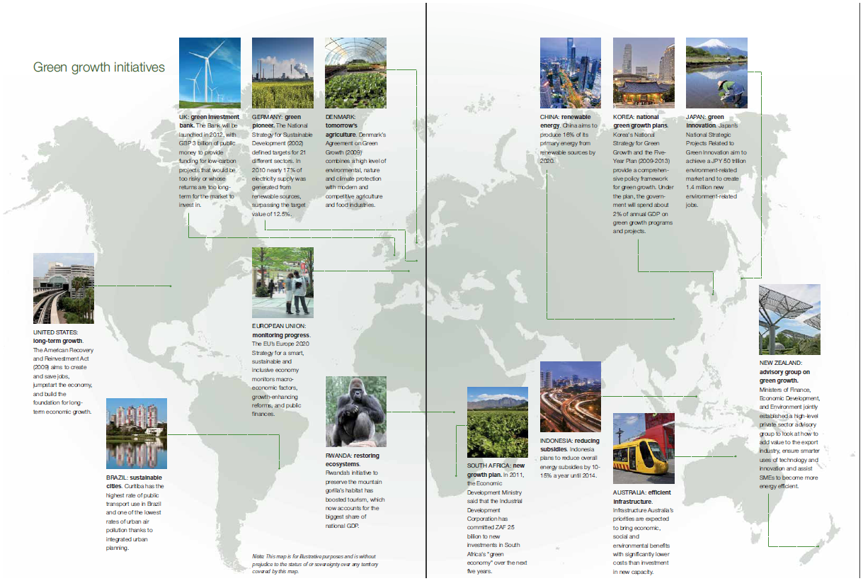
Connecting people to green growth across the globe

Slide 3
People working together with national governments…
Businesses
Researchers
Advisory Body to the French Minister of Environment, Sustainable Development and Energy
Professors
International organisations
Civil society
International
organisations
Source: Conseil Economique pour le Développement Durable (CEDD):
http://www.developpement-durable.gouv.fr/Rapports,13175.html.

Slide 4
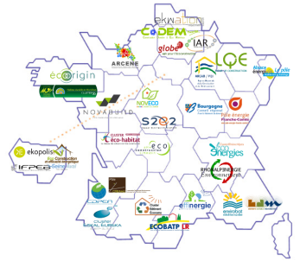
… people cooperating across regions …
Sustainable Building Plan
Intra-cluster
Companies
Training organisations
Research institutes
Public contractors
Source: Grenelle de l'environnement
http://www.developpement-durable.gouv.fr/-Le-Grenelle-de-l-environnement-de-.html

Slide 5
... university + industry + local government ...
Copenhagen Clean-tech Cluster
Danish Technical University
University of Copenhagen
Copenhagen Capacity
DHI
Scion DTU
Symbion
State of Green
Business Frederiksund
City of Copenhagen
Danish industries
Business Link
Martinez-Fernandez, C., et al. (2013), "Measuring the Potential of Local Green Growth: An Analysis of Greater Copenhagen", OECD Local Economic and Employment Development (LEED) Working Papers, No. 2013/01, OECD Publishing. doi: 10.1787/5k4dhp0xzg26-en

Slide 6
... public private partnerships to finance green investment needs
Amsterdam Sustainability Programme
Green Deal =
Amsterdam + national government
Green Finance Lab = Amsterdam + Bank ABN AMRO
Sources:
OECD (2013), Green Growth in Cities, OECD Green Growth Studies, OECD Publishing. doi: 10.1787/9789264195325-en ; A Green Metropole: Amsterdam Definitely Sustainable

Slide 7
... hearing people’s voice in strategic plans ...
Objectives and policy directions based on consensus
Governmental organisations
Industry
Academia
Civil society
Integrated plan
Collaborative process
Source: Korea’s Five-Year Action Plan for Green Growth; Green Growth in Action – Korea: http://www.oecd.org/korea/greengrowthinactionkorea.htm

Slide 8
... where tomorrow’s citizens count ...
School as a source of learning for environment
GREEN SKILLS AND INNOVATION FOR INCLUSIVE EMPLOYMENT GROWTH
14 February 2014, OECD Headquarters
→ How skills, education and training systems support new areas of growth?

Slide 9
... and international cooperation
can sustain global action ...
European Resource Efficiency Platform
Other initiatives
Green Growth and Sustainable Development Forum

Slide 10
... to avoid the dire straits of inaction.

Slide 11
SOCIO-ECONOMIC DEVELOPMENTS:
Growth in GDP Per Capita by Region

Slide 12
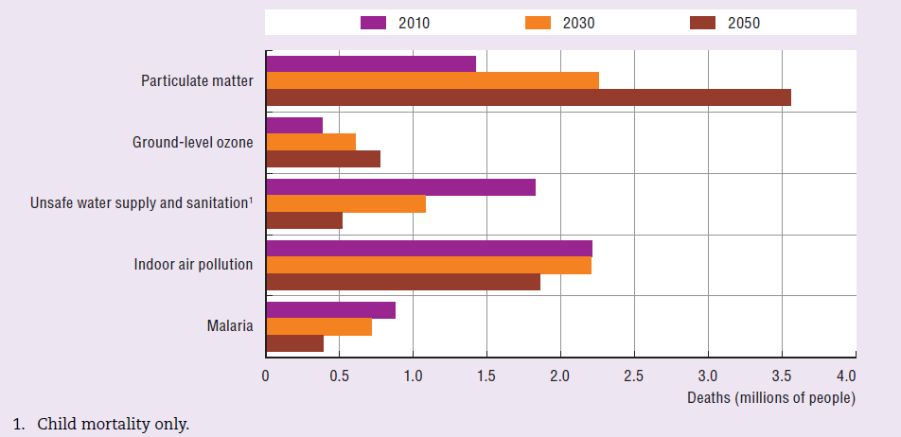
HEALTH & ENVIRONMENT: Urban air pollution to become the top environmental cause of premature deaths
Global premature deaths from
selected environmental risks: Baseline, 2010 to 2050
Source: OECD Environmental Outlook to 2050: Consequences of Inaction

Slide 13
HEALTH & ENV: Urban air pollution is already worse than WHO safe levels in most cities
PM10 concentration in major cities: Baseline, 2010-2050
WHO Air Quality Guideline

Slide 14
How to build a greener economy?
Green the tax system
Carbon tax
Broaden the environmental tax base
Differentiated excise taxes on fuels & energy
Tax vehicles to reflect their environmental performance
Extend market incentives
Strengthen pollution price signals
Eliminate environmentally harmful subsidies
Price natural resources to reflect their scarcity
Strengthen monitoring and enforcement capacity
Provide consumers with simple, transparent information
Mainstream Green Growth
Ensure government policies send the same signals to producers, consumers & investors
Require Economy & Finance Ministries to share the lead
Compensate low-income households for the costs of the green transition
Innovate and trade
Scale-up investment in low-carbon mass transit and integrate with urban planning

