Slide 1
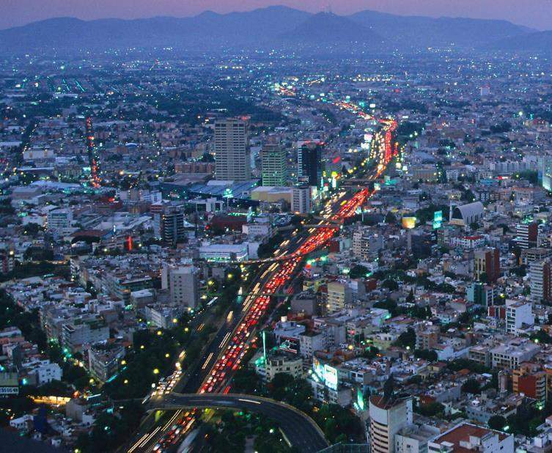
Ecological Footprint and China for a Global Shift
生态足迹与 中国领跑世界革新
Jim Leape
Director General
WWF International
吉姆·利普
WWF全球总干事

Slide 2
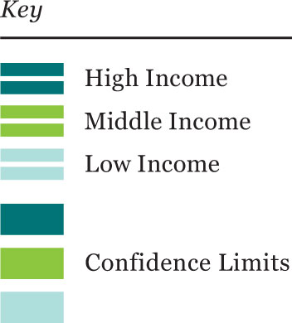
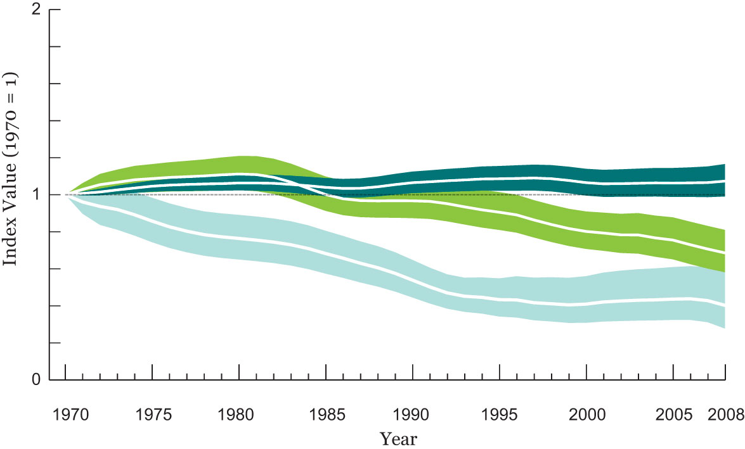
Living Planet Index by Income
收入与地球生命力指数
60% decline
in low-income
Countries
低收入国家的地球生命力指数下降60%
WWF / ZSL, 2012

Slide 3
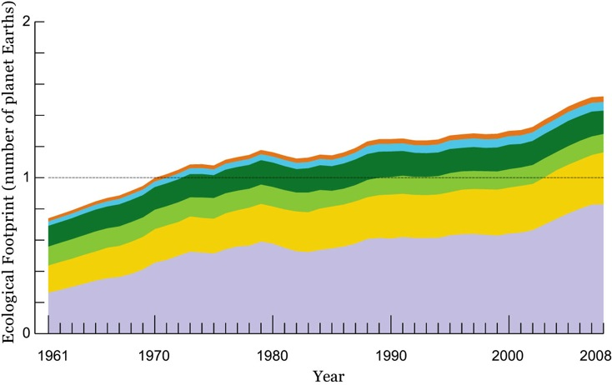
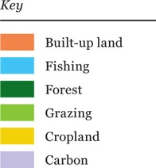
Ecological Footprint 生态足迹
50% in excess of Earth’s regenerative capacity
超出地球可再生能力的50%
Global Footprint Network, 2011
Notes:
The Ecological Footprint, in partnership with GFN, tells us why:
Footprint has doubled since 1966. In 2008, the most recent year for which data are available, the footprint exceeded the Earth’s biocapacity – the area of land and productive oceans actually available to produce renewable resources and absorb CO2 emissions – by more than 50 per cent.
Our current overshoot is largely due to carbon emissions: and has grown 11-fold since 1961.
The largest component of the Ecological Footprint is the carbon footprint (55%). At a national level the carbon footprint represents more than half the Ecological Footprint for one-quarter of the countries tracked. It is the largest component for approximately half the countries tracked

Slide 4
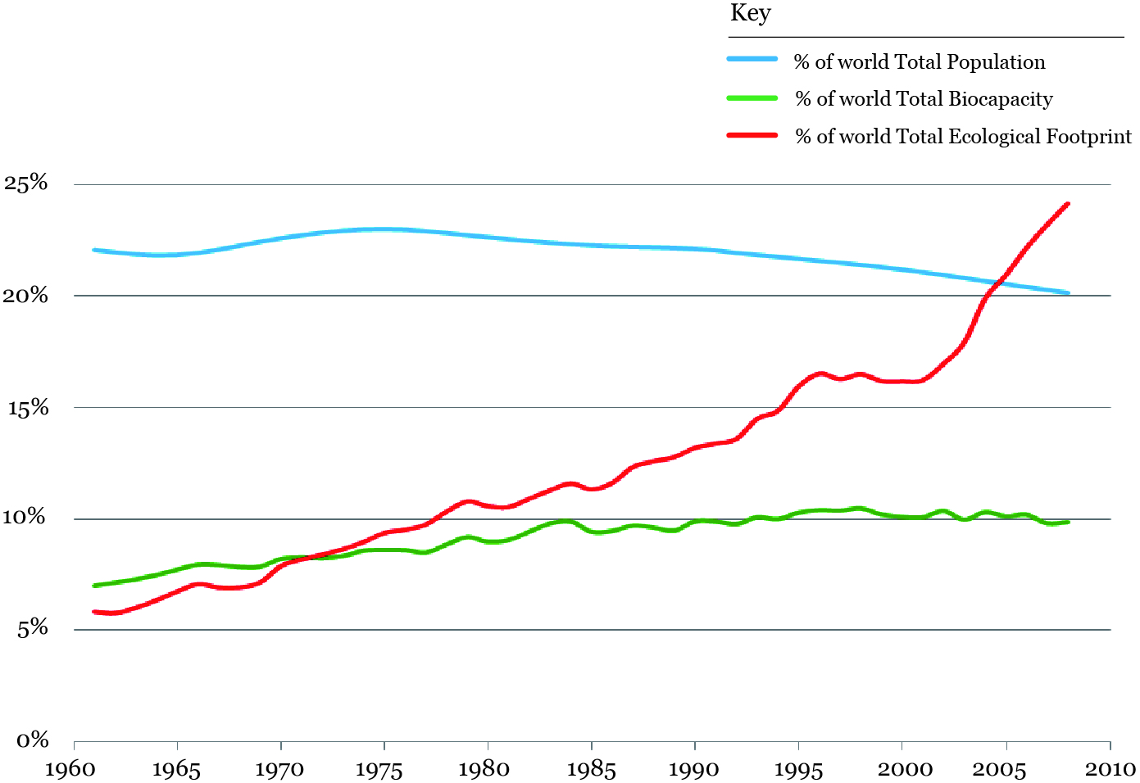
China now has the world’s largest footprint 中国-生态足迹总量全球最大

Slide 5
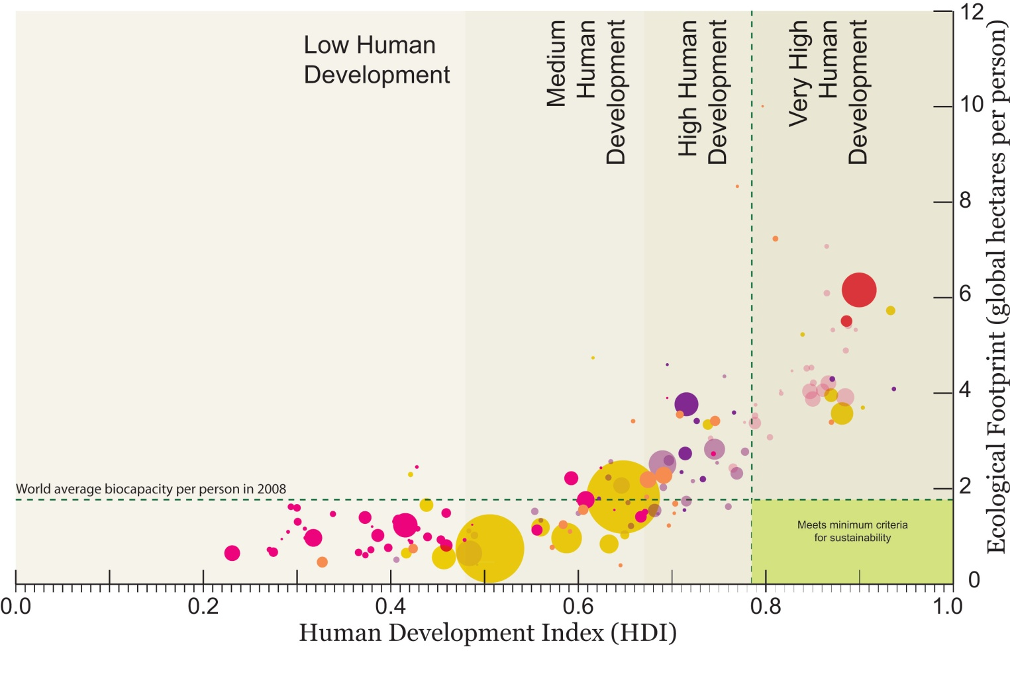
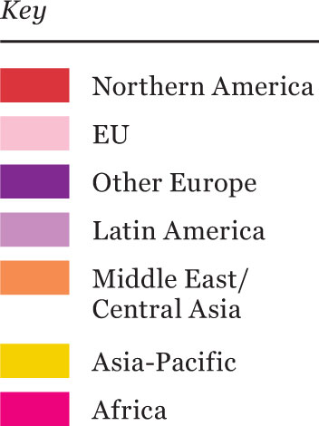
Development and Human Well-being
发展与人类福祉
人均生态足迹
人类发展指数
Global Footprint Network, 2011.

Slide 6
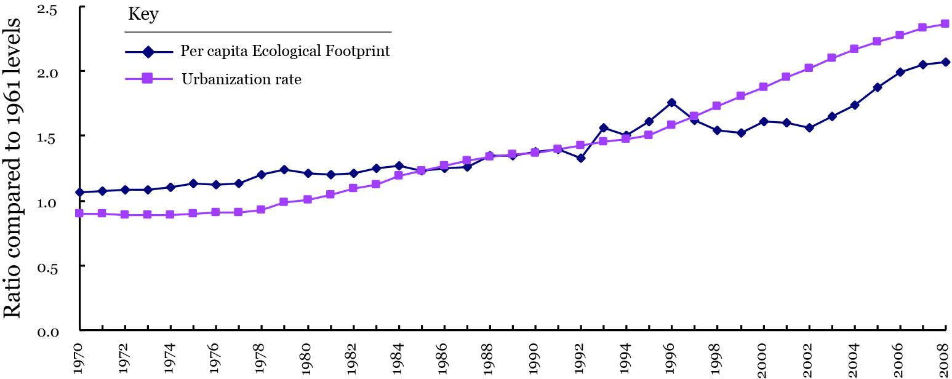
Footprint increases with urbanization
中国生态足迹随城镇化进程增加
人均生态足迹
城镇化率

Slide 7
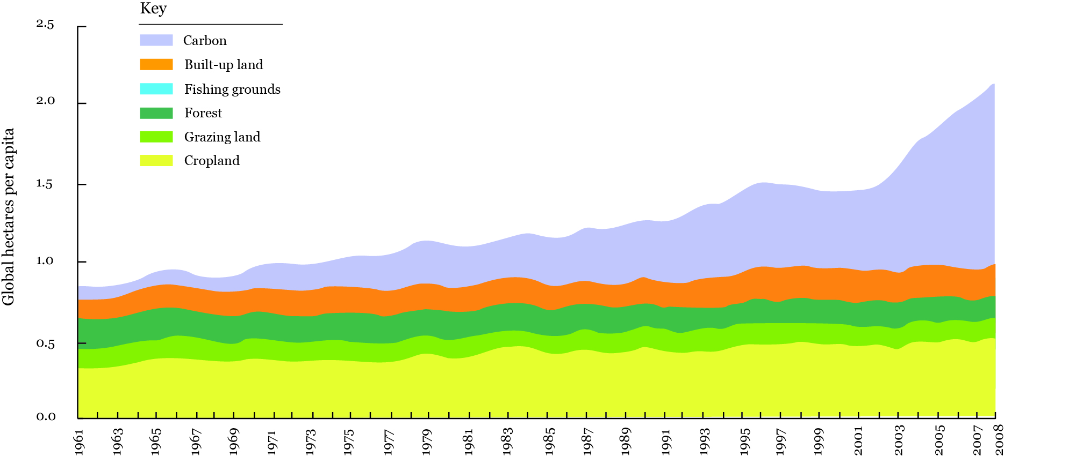
54% of China’s footprint is carbon 中国54%的生态足迹来自于碳足迹
Carbon footprint has become the largest component in Ecological Footprint and the fastest growing component over the past 50 years, from 10% in 1961 to 54% in 2008. 碳足迹成为中国生态足迹中最大也是上升最快的组分，从1961年的10%上升到2008的54%。

Slide 8
China is a world leader in renewable energy
中国的可再生能源发展世界领先
© Brent Stirton / Getty Images / WWF-UK
Notes:
Examples
China renewable energy - Solar panels. The Chinese Government has supported the development of this housing estate as part of their countryside / village act, which amongst its objectives, aims to improve the quality of life for rural citizens through improved housing. At the first stage of this eco-village there are over 600 flats that use solar energy for heating water, there is also an artificial wetland which treats the waste water. There are plans to build 2,000 eco-flats at this site. Xian Gang Eco-Village, Dong Xi Hu District, Wuhan City.

Slide 9
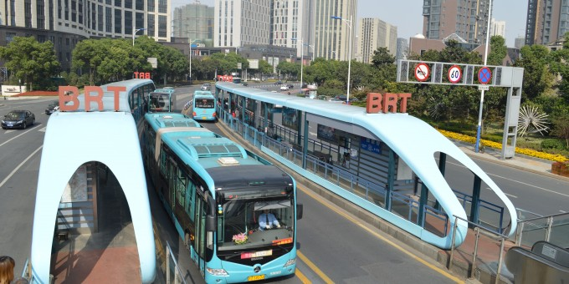
China is increasingly a leader in urban transit
中国正日益成为发展城市公共交通的领导者

Slide 10
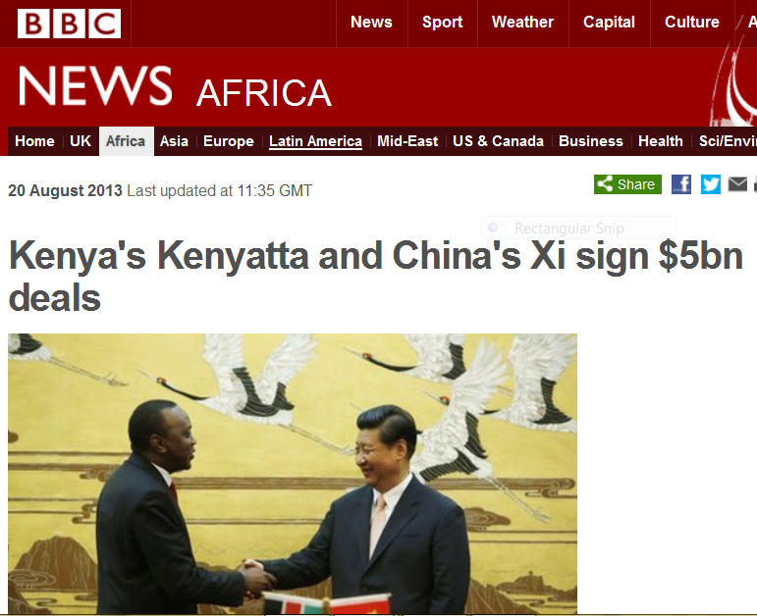
肯尼亚与中国签署50亿交易

Slide 11
Since 1999, Africa’s growth tracks China’s
1999年以来，非洲的经济发展与中国高度相关
11
Notes:
There is a very strong correlation between China and Africa GDP. As largest investor China’s growth has become a driver for African growth
Several African countries have plans to develop green economies, so it is a good time for both to pin down what green economy means and take concrete action to make it become a reality.

Slide 13
Between 2000 and 2012, trade between China and Latin America grew by
2,550 %
from $10 billion to $255 billion
2000至2012年间，中国与拉丁美洲的贸易额增长2550%，从100亿增长到2550亿
World Policy Institute, July 2013

Slide 14
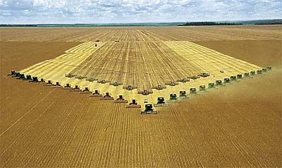
Notes:
14
This is the agricultural frontier in Brazil. It was formerly forest.
The photo shows the soy harvest followed immediately by planting corn—2.4 crops per year, 5 years and counting.

Slide 15
China is the top buyer of many Global Priority Commodities 中国是很多全球主要大宗商品的重要消费国
2
1
4
3
1
palm oil
cotton
biofuels
sugarcane
pulp & paper
1
3
3
1
1
timber
dairy
beef
soy
fish oil & meal
1
1
1
farmed fish
farmed shrimp
tuna
tropical shrimp
whitefish
Notes:
China is the top the top importer/processor/consumer of 13 out of 15 Global Priority Commodities

Slide 16
Ecological Footprint 生态足迹
50% in excess of Earth’s regenerative capacity
超出地球可再生能力的50%
Global Footprint Network, 2011
Notes:
The Ecological Footprint, in partnership with GFN, tells us why:
Footprint has doubled since 1966. In 2008, the most recent year for which data are available, the footprint exceeded the Earth’s biocapacity – the area of land and productive oceans actually available to produce renewable resources and absorb CO2 emissions – by more than 50 per cent.
Our current overshoot is largely due to carbon emissions: and has grown 11-fold since 1961.
The largest component of the Ecological Footprint is the carbon footprint (55%). At a national level the carbon footprint represents more than half the Ecological Footprint for one-quarter of the countries tracked. It is the largest component for approximately half the countries tracked

Slide 17
Ecological Footprint 生态足迹
50% in excess of Earth’s regenerative capacity
超出地球可再生能力的50%
Global Footprint Network, 2011
Notes:
The Ecological Footprint, in partnership with GFN, tells us why:
Footprint has doubled since 1966. In 2008, the most recent year for which data are available, the footprint exceeded the Earth’s biocapacity – the area of land and productive oceans actually available to produce renewable resources and absorb CO2 emissions – by more than 50 per cent.
Our current overshoot is largely due to carbon emissions: and has grown 11-fold since 1961.
The largest component of the Ecological Footprint is the carbon footprint (55%). At a national level the carbon footprint represents more than half the Ecological Footprint for one-quarter of the countries tracked. It is the largest component for approximately half the countries tracked

Slide 18
Global markets are shifting to certified sustainable commodities 全球市场向可持续认证商品转型
海洋管理委员会
森林管理委员会
棕榈油认证

Slide 19
© Carlos G. Vallecillo / WWF-Canon
Notes:
There are solutions, and this year’s report sketches the elements
Reducing Footprint
Energy – more than half the EF
Getting much more out of the energy we use
A determined drive to renewables

Slide 20
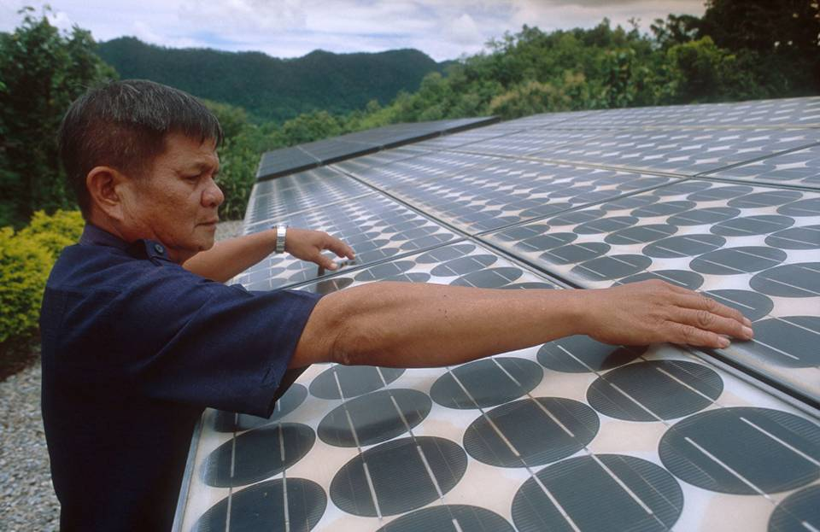
© Brent Stirton / Getty Images / WWF-UK
Notes:
Examples
China renewable energy - Solar panels. The Chinese Government has supported the development of this housing estate as part of their countryside / village act, which amongst its objectives, aims to improve the quality of life for rural citizens through improved housing. At the first stage of this eco-village there are over 600 flats that use solar energy for heating water, there is also an artificial wetland which treats the waste water. There are plans to build 2,000 eco-flats at this site. Xian Gang Eco-Village, Dong Xi Hu District, Wuhan City.

