Slide 1
How can a green Belt and Road help achieve the Sustainable Development Goals?
绿色的一带一路如何帮助实现可持续发展目标？
Magdy Martinez-Soliman
马戈迪·马丁内兹-苏莱曼
Assistant Secretary-General
联合国助理秘书长
Director of the Bureau for Policy and Programme Support, United Nations Development Programme (UNDP)
联合国开发计划署政策与项目支持局局长
11.11.2015

Slide 2
Contents
1
A brief introduction to the SDGs
可持续发展目标简介
2
Greening the “Belt and Road”
共建绿色丝绸之路
The role of new banks and China’s private sector
新近成立的银行及中国私营部门的角色
3
4
UNDP’s support
联合开发计划署的支持

Slide 3
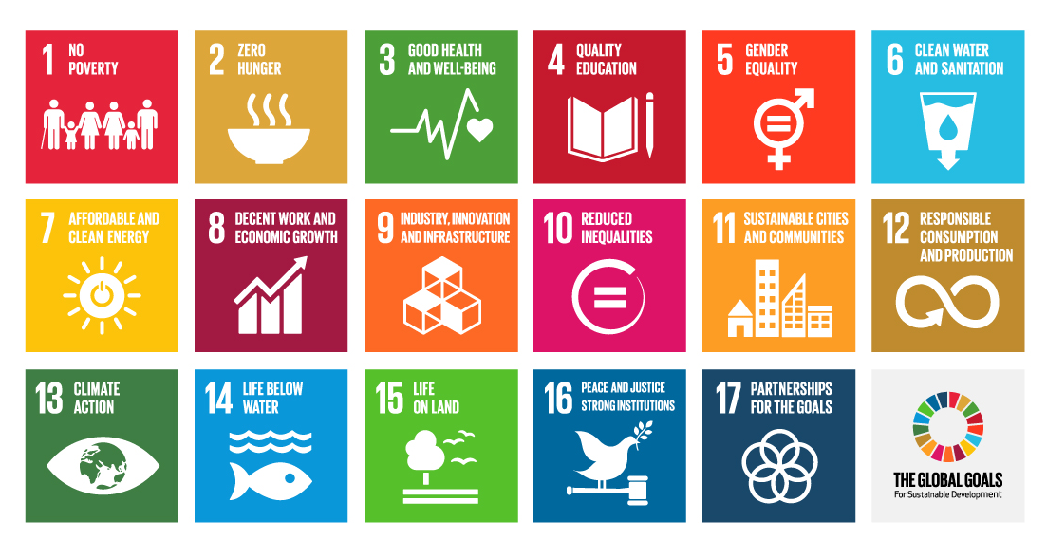
The Global Goals for Sustainable Development
可持续发展目标
Notes:
The new 17 SDGs, just adopted by the world leaders at the UN Summit in September, are very important and certainly an extension of the MDG approach - in that they are designed to galvanise all countries and people around issues that are important to human development, and wellbeing.
But they are also different in four ways. First, the process for designing the SDGs was different. Many more countries and citizens were involved this time round - for example, through the My World survey which over 5 million people filled out. Second, the SDGs will not just apply to poor countries, as it has been recognised that there can be extremely poor people in the richest of places. The SDGs will apply to all countries, including China again. Third, they will include aspects of development that had less focus in the MDGs - such as job creation, a better environment, more equality. And finally, we live in a more complex world today, with a lot of interdependencies between issues and among countries. The SDGs have also acknowledged this and called for strengthened global partnership, outlined by Goal 17, to tackle this.
But how does this relate to China’s Belt and Road Initiative?

Slide 4
If the “Belt and Road” can be made more green…
如果“一带一路”能够更加绿色。。。。。。
Trade and investment
贸易和投资
Goal 17
Partnership
全球合作
伙伴关系
Infrastructure building
基础设施建设
Technology transfer
技术转移
Notes:
Well, as we know, China’s Belt and Road Initiative (BRI) covers 60 countries and regions with a total population of 4.4 billion. It has many facets, but it also has a special focus on promoting inter-governmental cooperation, facilitating connectivity, and stimulating the movement of goods, services and people across national borders.
All of these provide great opportunities to achieve the SDGs, particularly Goal 17, which - as mentioned earlier - places strong emphasis on strengthened global partnership for sustainable development, including south-south cooperation.
In addition, if the Belt and Road can be “more green”, this will be even more positive for achieving the SDGs. It could serve as an effective vehicle to channel trade and investment, facilitate infrastructure building and transfer technology, all of which can be directed to the green sector to achieve low-carbon growth of countries involved.
How could this happen? Two mechanisms. The development financing related to the Belt and Road, and China’s private sector.

Slide 5
The role of new banks in green development finance
新近成立银行在绿色发展中的角色
AIIB
$100 billion
SRF
$40 billion
And more?
GCF
$100 billion
per year
GEF
$70 billion
WB Green Bond
$8.4billion
AIIB: Asian Infrastructure Investment Bank
GCF: Green Climate Fund
GEF: Global Environment Facility
WB: World Bank
SRF: Silk Road Fund
Notes:
This graph illustrates the opportunity with regard to development financing – in numbers.
If we take a quick look at some of the existing funding mechanisms for “green growth” (or “ecological civilization” as it is known in China) in this regard:
GCF aims to mobilize $100 billion per year by 2020
GEF has leveraged around $70 billion, including grants and co-financing, since its establishment in 1991
WB has issued 100 green bonds in 18 currencies, raising the equivalent of $8.4billion, which target low carbon and climate resilient growth in countries.
Compare these to the resources from AIIB and SRF, which, due to the Belt and Road Initiative, will have a total $140 billion initial funding.
If the AIIB and SRF resources can be targeted to green investment, these newly established financial institutions, will be able to provide huge, and comparable finance for green growth. It is very promising indeed…

Slide 6
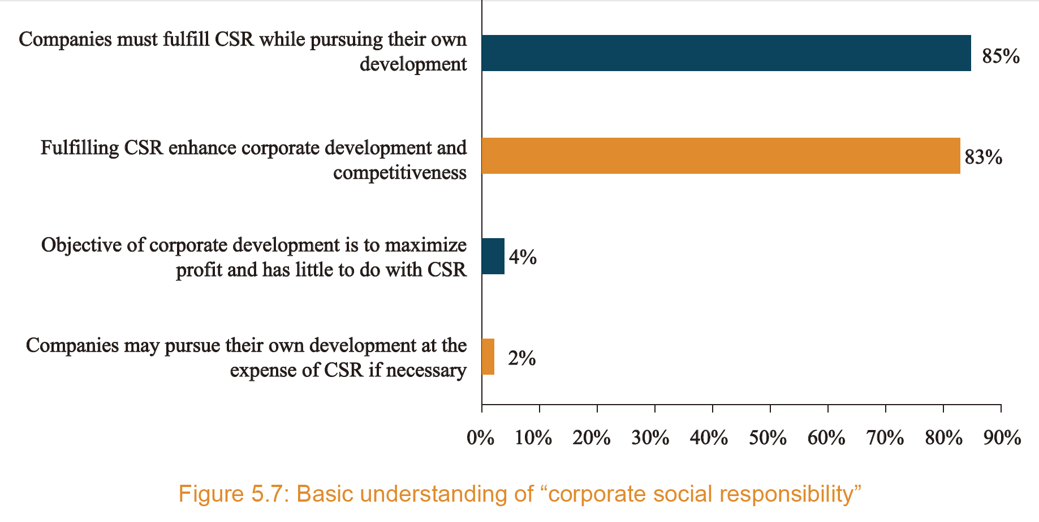
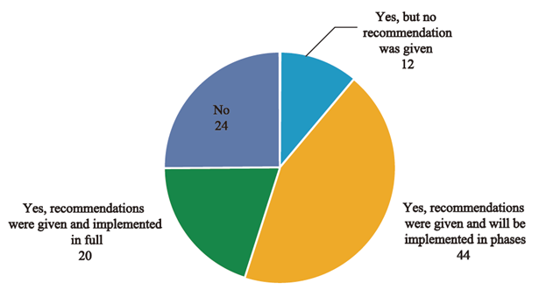
The role of China’s private sector
中国私营部门的角色
Notes:
And the second mechanism is business. During the SDG discussions, it was recognized that businesses will play a vital role in the implementation of the SDGs, and here in China their role in the Belt and Road Initiative is also expected to be huge. Chinese businesses will increasingly go abroad to developing countries, during the implementation of the Belt and Road Initiative. Actively pursuing sustainable development through their business models can make a huge difference.
And indeed, many are already doing their very best. As is shown on the slide, the 2015 Report on the Sustainable Development of Chinese Enterprises abroad, just launched yesterday by UNDP, Chinese Academy of International Trade and Economic Cooperation and Research Center of State-owned Assets Supervision and Administration Commission of the State Council, found that over 80% of Chinese companies with overseas operations recognize the importance of CSR to corporate development and competitiveness.
Yet there is more to do. For instance, as is demonstrated in the pie chart, the study also found that over 75% of Chinese companies engaged third parties to conduct environmental impact assessments of their overseas activities, suggesting a high degree of concern for green and sustainable practices. Yet only 20% of them had actually implemented the recommendations from these assessments, so they need a great deal of support if their concerns are to be made into a reality.

Slide 7
What can UNDP support?
联合国开发计划署可提供何种支持？
UNDP’s role
联合国开发计划署的角色
Support China in working with other countries: South-South Cooperation
支持中国与其他发展中国家的合作；即南南合作
Support China and Belt and Road countries to work together and make their cooperation as sustainable as possible
支持中国与丝绸之路沿线国家的合作并保证其尽可能符合可持续发展的原则
Notes:
This brings me to the role of organizations such as UNDP in supporting green development financing and business going forward.
Over the last 5 years UNDP has been partnering with China to share its unique development experiences with the world, while also supporting China to strengthen its approach to South-South and Global Cooperation. This is very important. Many developing countries see China as an inspiration for achieving development results, as its development experiences are recent and very relevant – many developing countries have similar institutions and challenges that China faced 30 years ago. At the same time, I believe China also wants to have a positive impact on the achievement of the global goals by other countries. Therefore, as there is this mutual desire for cooperation, it is important for UNDP to be there to support it to happen.
I believe what UNDP can do here – given its own expertise – can be to help China and the Belt and Road countries to work together to make their collaboration as positive for sustainable development as possible. This can be done in a whole range of ways – for example hosting workshops, doing research, carrying out practical projects, and so on. I’ve been speaking with several Chinese leaders about this and I believe this will be an interesting and important area of work going forward for us.

Slide 8
Thank You !
Notes:
Ladies and Gentlemen, thank you for your attention, and I look forward to fruitful and productive discussion this morning with you all.

