Slide 1
Greening One Belt One Road
The Role of NGOs
民间组织在绿色“一带一路”建设中的作用
Diane Regas
Executive Director
Environmental Defense Fund
黛安·雷加斯
执行副总裁
美国环保协会

Slide 2
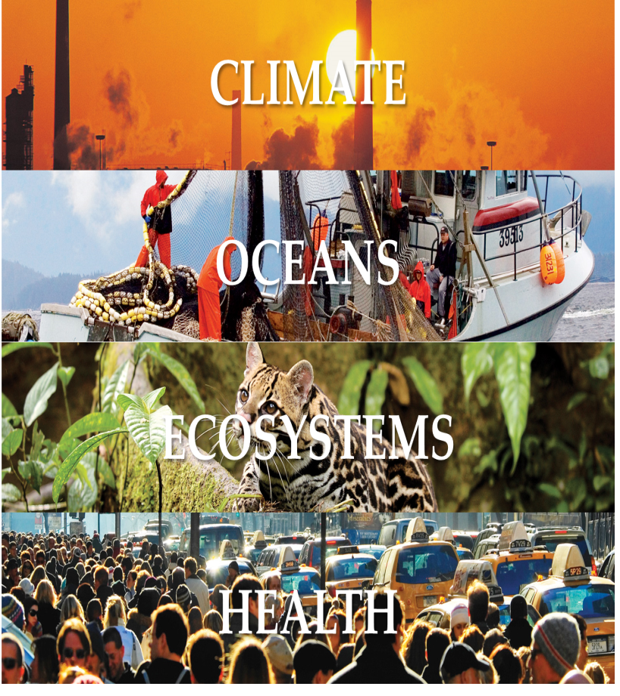
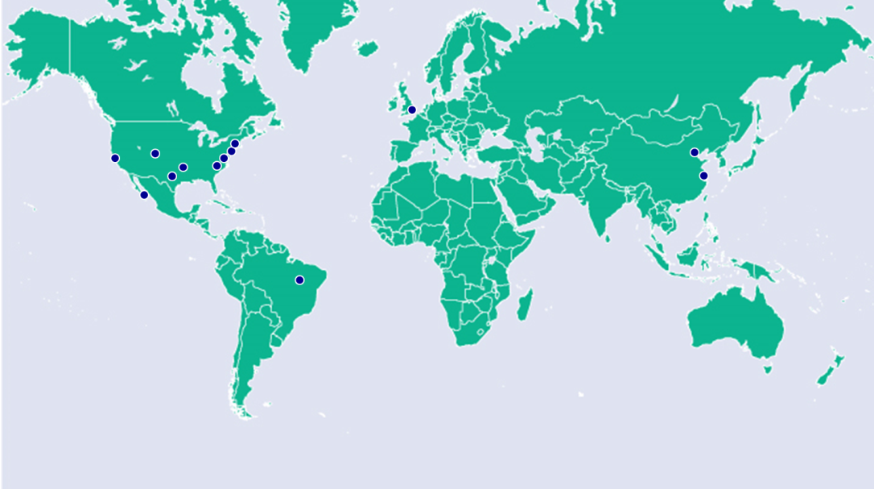
EDF & experiences美国环保协会国际化经验
Leading non-profit environmental group in U.S. founded in 1967 美国著名的非营利组织
Based on sound science and economics, find practical and lasting solutions to the most serious environmental problems. 基于坚实的科学基础与经济学方法，致力于为最紧迫的环境问题提供解决方案
Focused on oceans, climate, ecosystems, and health,关注海洋、气候、生态和健康
Internationalization to protect environmental commons. 国际化

Slide 3
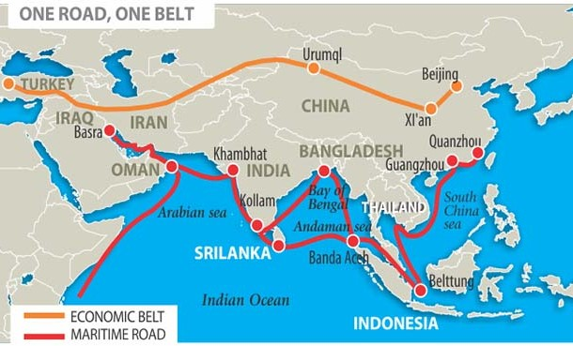
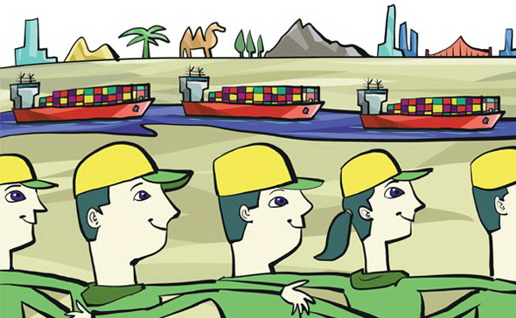
Internationalize Chinese NGOs to green one belt and one road
中国NGO国际化推动绿色一带一路
The internationalization of Chinese NGOs should be an important adjunct to China‘s One Belt, One Road initiative. 中国民间组织的国际化应当成为“一带一路”战略的重要助力。

Slide 4
Sharing experiences with countries along the Belt and Road 与一带一路沿线国家共享环保经验
Environmental governance -New
environmental law
环境治理体系新环保法
Green Finance
绿色金融
Green Supply Chain
绿色供应链
China’s
Experiences
中国经验
Power of Markets
市场的力量
Regional environmental Management
区域环境管理

