Slide 1
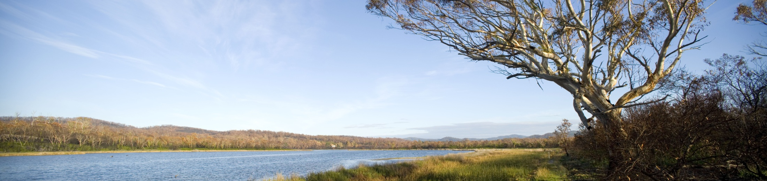
Institutional Innovation for Environmental Management: The Australian experience
2014 CCICED Annual General Meeting
Roger Beale AO

Slide 2
Innovation
Innovation in environmental policy is underpinned by four elements:
Institutions provide holistic management frameworks
Trust between government, business and communities is essential to make policy ‘stick’
Principles, including robust science, provide strategic guidance
Rules enable the implementation of innovative policy
Institutional innovation, coupled with effective trust, principles and rules, has been fundamental to successful water, marine and carbon abatement policy

Slide 3
Three Examples
Murray Darling Basin
Illustrating scope, process and use of markets
Great Barrier Reef
Managing the world’s largest reef system off-shore from intensive agriculture, mining, industry
Greenhouse emissions reduction
Perils of losing public trust

Slide 4
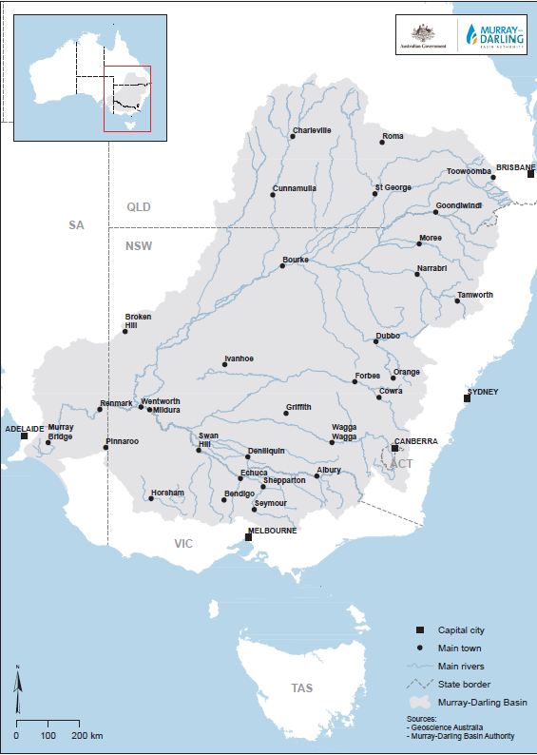
Managing Water Availability in the Murray-Darling Basin
The Murray-Darling Basin is 3,375 km long (Beijing to Bangkok)
Spans five jurisdictions:
Australia’s food and fibre basin
Supports many species and ecosystems, including many threatened species
environmental problems and competition for water use

Slide 5
Water Flow and Quality Problems
Increased salinity – irrigation and over-extraction
Increased nutrients from fertilizer, urban and animal run-off
Changed flow patterns impacting riverine species – risk of long term drying in South
Reduced flow and quality impacting down stream cities, agriculture and eco-systems
Intense competition for available flows - agriculture vs environment vs cities; upstream vs downstream

Slide 6
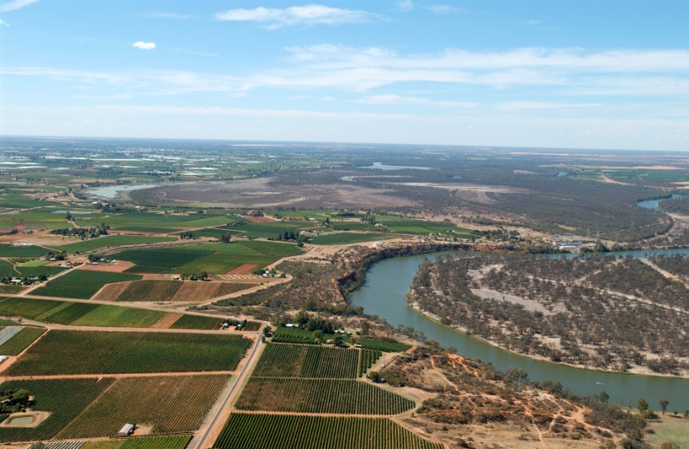
Murray Darling Basin Authority (MDBA)
Long history of squabbling over water sharing
Crisis reached in 10 year drought to 2008-09 - water availability fell by 53 per cent
MDBA formed by national law and inter-government agreement in 2008 to tackle sustainable use of river system.
Strong science base
First draft plan led to irrigation farmers “revolt” – plan rejected by governments
Plan “rebuilt” slowly and carefully – took 4 years

Slide 7
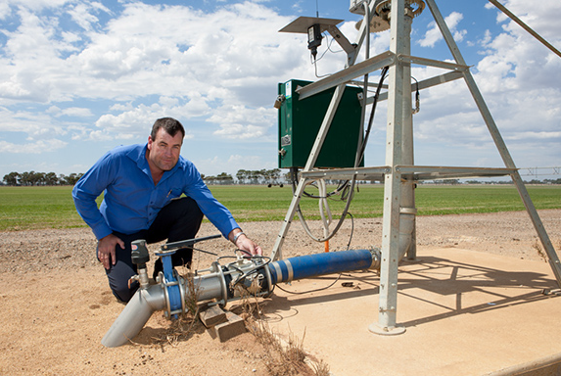
Maintaining trust in the Murray-Darling Basin
Talking and listening to all was key to mediation of competing interests
Basin communities have been engaged at all stages, and have been involved in developing sustainable water plans
Indigenous groups participate in Murray-Darling Basin planning and programs including environmental water delivery
Infrastructure funding helps local communities and agriculture to deliver water reduction targets

Slide 8
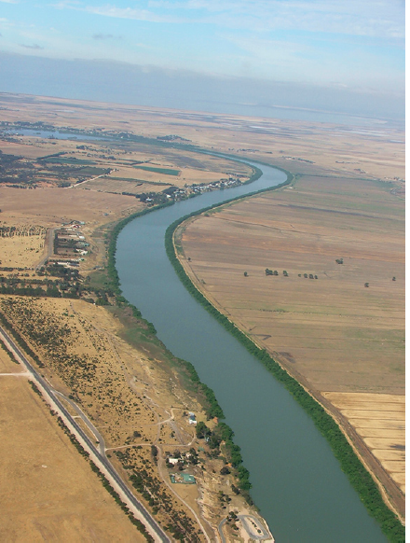
Principles for water management
Water property rights created for users – irrigators, utilities, cities etc
Australian government buys water for environment – so can NGOs
Advanced science and economic and social data assist decisions
Improved data helps water users make water use decisions
The National Water Account is set up like a financial balance sheet and operating statement

Slide 9
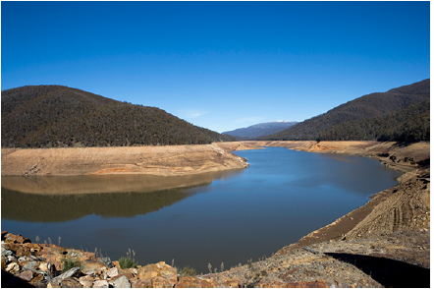
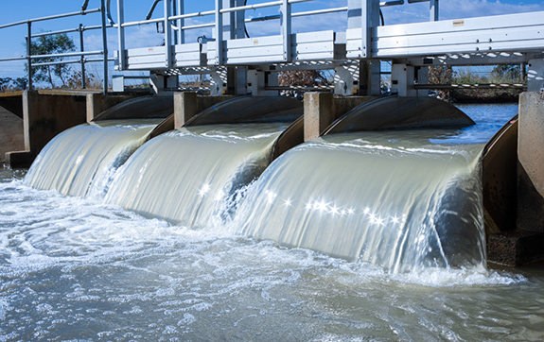
One of the world’s largest water trading systems
25 percent of water available for consumption before the Plan was agreed in 2012 to go to environment
Trading in water rights, and in annual allocations, give water users high levels of flexibility and incentive to use water efficiently
Large economic benefits resulted
An efficient water market is dependent on:
governments establishing clear water rights
an ability to undertake transactions in relation to those water rights
access to relevant market information

Slide 10
The Great Barrier Reef Marine Park
The Great Barrier Reef Marine Park
covers 344,400 km² in area
includes the world’s largest coral reef ecosystem
includes some 3000 coral reefs, 600 continental islands, 300 coral cays and about 150 inshore mangrove islands
It is one of the world’s best managed reefs, but faces threats such as climate change, acidification, continued declining water quality from catchment run-off, loss of coastal habitats from coastal development, illegal fishing and crown-of-thorns starfish outbreaks.

Slide 11
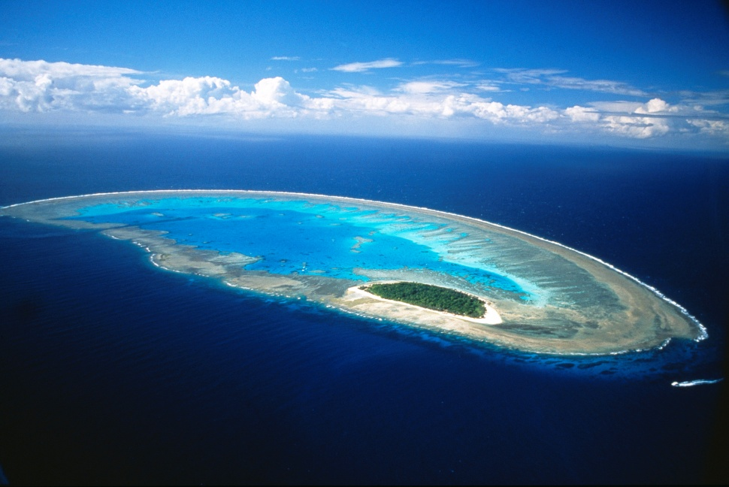
Great Barrier Reef Marine Park Authority (GBRMPA)
The Great Barrier Reef Marine Park Authority (GBRMPA) administers the 345,000 km² of the Great Barrier Reef Marine Park
The Marine Park is a multiple-use area that supports a range of communities and industries that depend on the Reef for recreation or livelihoods. Tourism, fishing, boating and shipping are all legitimate uses of the Marine Park
GBRMPA works with Traditional Owners, tourism partners, farmers and fishers, volunteer marine advisory committees and industry, as well as a range of state and Australian Government agencies.

Slide 12
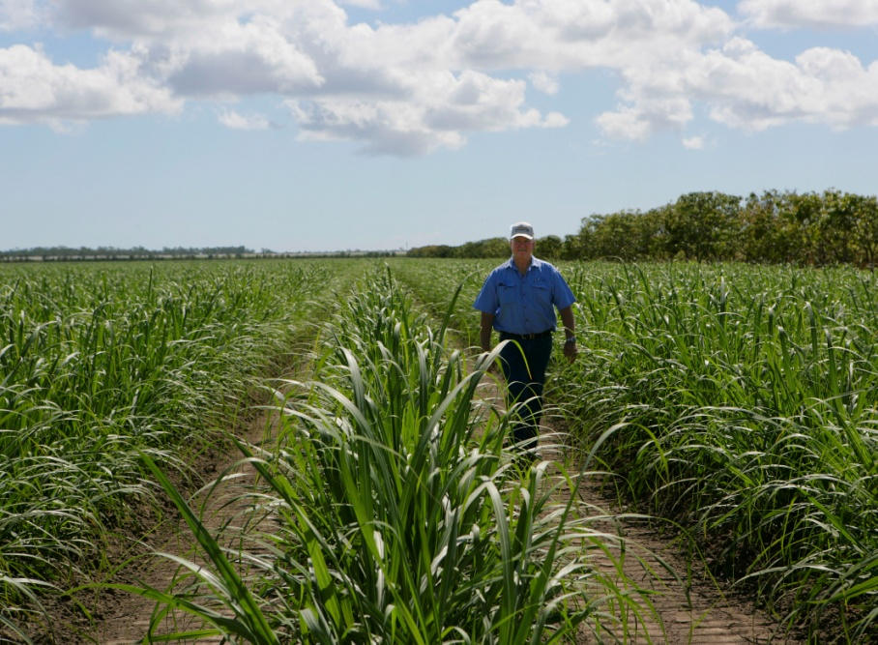
Engaging with the community
Agricultural land managers are being engaged to develop solutions to reduce run off to the Great Barrier Reef catchment
Indigenous Owners help plan and manage indigenous heritage, fishing and hunting
Fishers are engaged to continuously improve fishing gear and methods to reduce by-catch and reef damage
High technology surveillance of no-take zones – but still poaching
Strong control on aquaculture
Tight but still controversial controls of port development and shipping

Slide 13
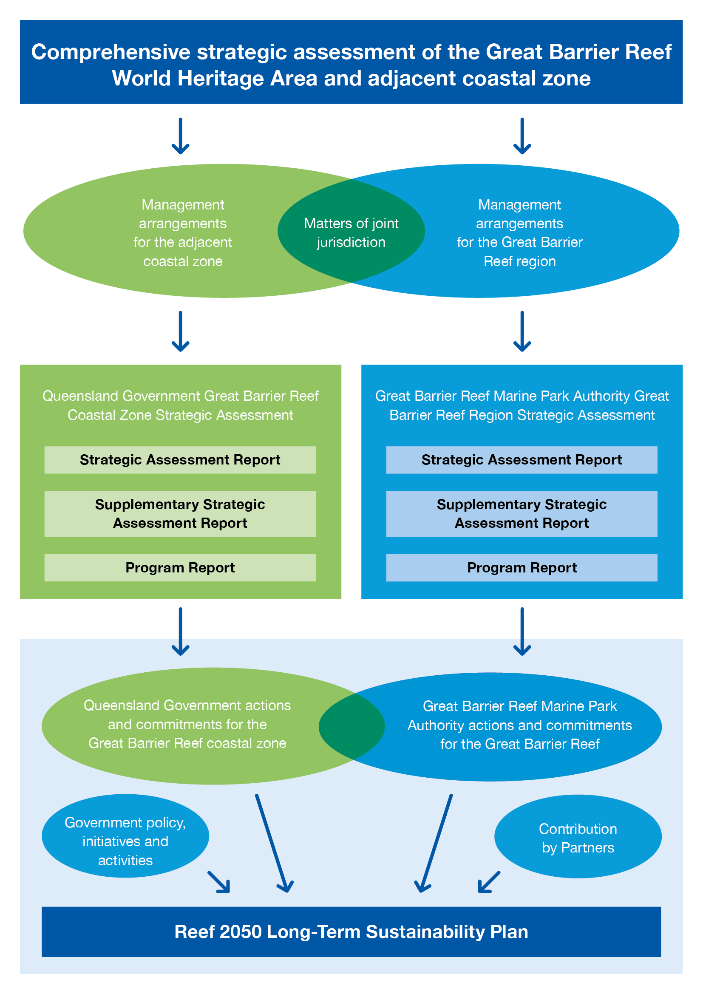
The Reef 2050 Plan
The Reef 2050 Plan blends science and negotiation with communities
Deals with key threats like poor water quality and crown-of-thorns starfish
It outlines actions to protect key species such as marine turtles and dugong against the threats of poaching, illegal hunting and marine debris,
But stopping warming and acidification need global action

Slide 14
Innovative Rules: Reverse auctions for water quality
Competitive tender (or reverse auction) to improve water quality
Sugar cane farmers submit bids for funding to reduce nitrogen run off
Farmers will bid their nitrogen reduction commitment and choose the most cost-effective means of achieving them
Bids will be assessed competitively on a cost-effectiveness metric

Slide 15
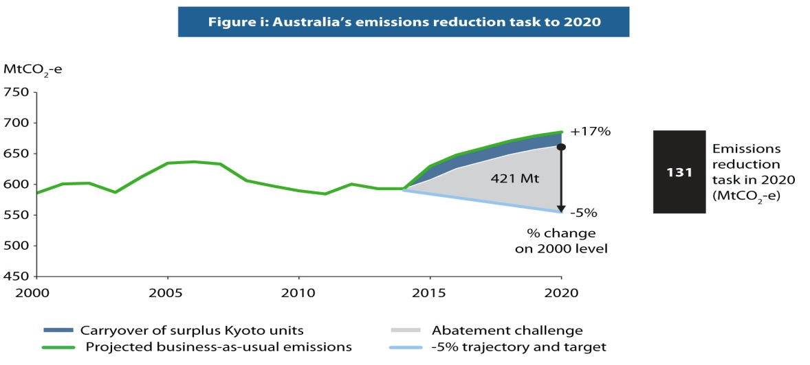
Meeting Australia’s carbon emissions target
Australia is committed to meeting its emissions reduction of five percent below 2000 levels by 2020
A carbon tax was imposed from 2009 but repealed in 2014 after being an election issue

Slide 16
It is not just economics
Most economists thought that the carbon tax leading to emissions trading was most low cost long term measure
But the public found it hard to understand the link between carbon price and emissions reduction
Preferred “direct action” through mandating or subsidizing renewables and government purchase of emissions reductions through activities such as revegatation, capturing methane from waste and energy efficiency improvements in the commercial building sector and industry.

Slide 17
The Clean Energy Regulator
Fundamental to taxing or trading emissions or subsidising their reduction is measurement and reporting
Emissions, and emissions reductions, need to be measured independently and accurately.

Slide 18
The Clean Energy Regulator
The Regulator runs the National Greenhouse Emissions register – a single national framework for reporting and disseminating company information about greenhouse gas emissions, energy production, energy consumption.
It also oversights reporting and the issuing of certificates under the Renewable Energy Target
It will regulate access to payments under the new government’s Emissions Reduction Fund by certifying that contracted emissions reductions have been provided.

