Slide 1
生态文明建设背景下的环境保护制度体系创新研究
Institutional Innovation for Environmental Protection
in the Context of Ecological Civilization
王玉庆 中国环境科学学会理事长
WANG Yuqing President of Chinese Society of Environmental Sciences
罗宾·克拉克 澳大利亚可持续发展、环境、水务、人口与社区部前秘书长
Robyn Kruk Former Secretary of Department of Sustainability, Environment, Water, Population and Communities, Australian Government
Dec 2, 2014

Slide 2
主要内容
Contents
一、背景及研究过程
1. Background and Approach
二、主要研究结论
2. Key Findings
三、国际经验综述
3. International Experiences
四、主要政策建议
4. Policy Recommendations

Slide 3


一、背景与研究过程
1. Background and Approach
（一）研究背景 1.1 Background
十八大将生态文明纳入社会主义现代化建设五位一体总体布局，融入经济、政治、文化、社会建设，有力推进中国环境保护的进程。
十八届三中全会提出加快建立生态文明制度体系，用制度保护环境，改革生态环境保护管理体制。
中国高速工业化城市化，资源环境问题日益突出，人民迫切希望改善环境质量。
当前中国环境治理体系及环保制度亟待改革。为此国合会设立年度重点课题，开展环境保护制度创新的研究。本研究适应形势发展需要，有必要性和紧迫性。
18th CPC National Congress: ecological civilization (EC) & promotion of environmental (env.) protection are key for China’s modernization.
3rd CPC Plenary: outlined comprehensive strategy for establishing EC institutions and reforming ecological and env. management systems.
Due to rapid industrialization, China faces serious resource & env. problems. National consensus behind need to improve env’l quality.
China’s env’l management system has many defects and needs reform.
CCICED Task Force to Study Institutional Innovation for Environmental Protection (2014).

Slide 4
（二）研究目标内容 1.2 Objectives and Scope
技术路线 Roadmap
识别当前中国环境治理体系、环境保护制度存在的主要问题，分析其现状与生态文明建设要求及国家环境治理目标之间存在的差距，重点研究环境保护体制机制创新，特别是关键的制度创新需求，在借鉴发达国家经验及国内经验教训的基础上，提出中国环境治理体系现代化、环境保护制度改革与创新的基本思路和具体建议，为未来一段时期中国国家环境治理体系的变革和治理能力的提升、环境管理战略转型的顶层设计提供参考和支持。
Identified the prerequisites of ecological civilization, analysized the existing environmental governance system, compared institutional structures with best practices both domestically and internationally. Drawing on both domestic and international experiences and lessons. Made recommendations related to the modernization of China’s environmental governance system and the reform and innovation of its environmental protection institutions are made. Chinese and international case studies provide practical guidance relevant to the transformation of China’s environmental governance system, improving governance capacity, and developing an over-arching and strategic design for environmental management.

Slide 5
（二）研究目标内容 1.2 Objectives and Scope
本课题研究内容包括：推动国家环境治理体系改革和治理能力现代化，环境保护制度和体制创新，环境管理战略转型的顶层设计。
六个子课题：（1）环境治理体系的理论框架和现代化目标研究；（2）提高环境保护社会治理水平研究；（3）生态环境保护管理体制改革研究；（4）环境保护制度创新的总体思路研究；（5）环境管理战略转型的总体研究；（6）国际经验与案例。
Task Force objectives: Provide advice to: (1) accelerate reform of the national env’l governance system and improve env’l governance capacities; (2) stimulate innovations in env’l protection institutions and governance systems to improve env’l quality; (3) propose a top-level design for a strategic transformation of env’l management approaches. Sub-topics:
Theoretical framework and modernization objectives of China’s environmental governance system
Improvement of social governance capacity for environmental protection
Reform of Ecological & Environmental Protection Management Institutions
General Thoughts for Institutional Innovation for Environmental Protection
General Study on Strategic Transformation of Environmental Management
International Experiences and Case Studies

Slide 6
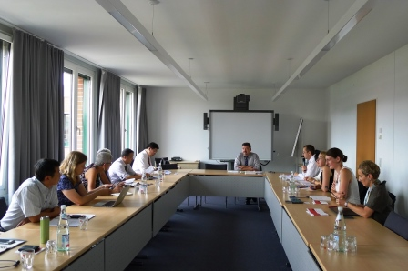
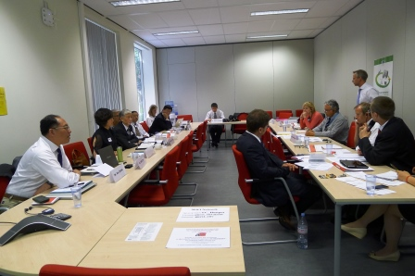
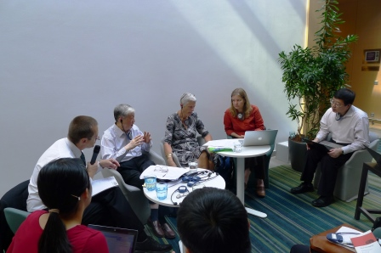

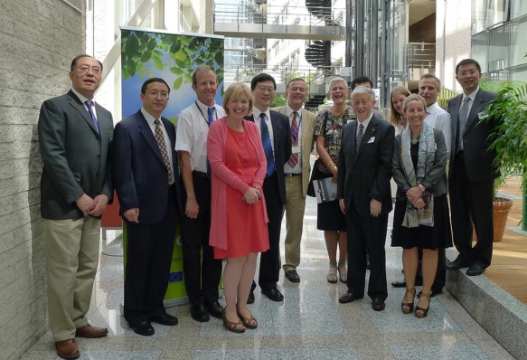
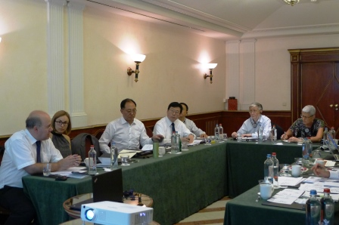
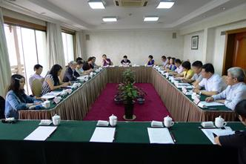
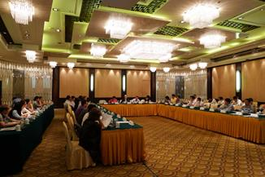
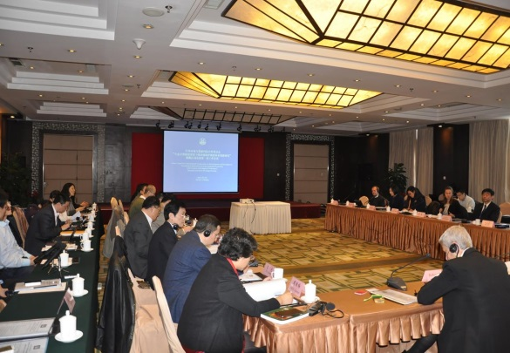
（三）工作进展 1.3 Progress
2014年2月 项目团队组建
2月21日 中方顾问研讨会论证方案
3月14日 课题启动会暨第一次全体会
6月21-24日 浙江、上海调研
6月23日 环境社会治理研讨会
7月15 报告初稿
7月18日 第二次中方顾问研讨会
7月23-30日 欧盟、德国调研
7月28日 第二次全体会议
8月 修改报告
9月14日 第三次中外方全体会议
9月22日 第三次中方顾问会论证报告
9月25-28 甘肃、宁夏调研
10月 完成最终稿，提交国合会
Feb. Chinese Team and Consulting team organized.
Feb.21 The 1st Consulting Meeting on the Implementation Plan.
Mar. 14 Inception and 1st Plenary Meeting.
June 21-24 Study tour to Zhejiang Province and Shanghai.
June 23 Workshop on Environmental Social Governance.
July 15 First Draft of Report
July 18 The 2nd Consulting Meeting on draft reports.
July 23-30 Study tour to EU
July 28 2nd Plenary Meeting in Berlin.
Aug. Revising draft report
Sept 14 3rd Plenary Meeting in Beijing.
Sept 22 3rd Consulting Meeting on the Final General report.
Sept 25-28 Study tour to Gansu Province and Ningxia District.
Oct. Final report submit to CCICED

Slide 7
二、主要研究结论 2. Key Findings
（一）中国严重的环境问题凸显国家环境治理体系缺陷
1、当前中国资源约束趋紧、环境污染严重、生态系统退化；
2、环境治理体系是国家治理体系的重要组成，治理体系和治理能力需要现代化；
3、政府过度集权，常常不能依法办事会；企业缺乏社会责任，违法排污严重；人民群众环境权益观念淡薄，参与能力不足。
（二）环境保护制度体系问题的根源：
1、发展阶段性；2、体制上-环保部门授权有限、能力薄弱，部门间环保职能交叉缺位，配置不合理，对地方监督缺乏体制安排；3、机制上-未重视环保监督考核，制度不合理，执行不到位，有利于环保的市场和公众参与机制缺位。4、指导思想上-存在经济发展优先于环境保护、收益大于环境破坏成本、当前经济收益重于未来环境成本的思想。
2.1 Serious env’l problems expose gaps in env’l governance
● Need to modernize env’l governance system & capacities to meet EC objectives & env. targets.
●Government reliant on traditional management models, enterprises lack sense of social responsibility, society has limited capacity for participation.
2.2 Problems in the existing env’l protection institutions
● Stage of development ● Env’l protection administrations lack influence, capacity, resources & authority and hindered by the pursuit of GDP ● Env’l responsibilities of government departments at times overlap, at times too dispersed ● Lack supervision, enforcement and participation mechanisms.
Misguided belief that the economy will continue to benefit through exploitation of the environment

Slide 8
二、主要研究结论 2. Key Findings
（三）环境保护体制改革
1、处理好三个关系：政府、市场与社会的关系；统一管理与专业分工管理的关系；中央与地方环保事权划分的关系。
2、总体方向：以环保大部制和增强权威性为改革方向，健全综合管理和专业分工格局，明确政府各部门环保职责，建立责任追究机制；完善跨区域协调机制以及对地方政府的监督机制；增强生态环境监管的统一性、独立性和有效性。
（四）环境管理战略转型：目标、方式和工作重点的转变
1、“十二五”开始，“十三五”各项环境管理工作应围绕环境质量管理开展。
2、平衡环境、经济和社会发展的关系，协调土地开发、资源利用与生态环境承载力的关系。改变过于依赖行政命令与管制手段，建立机制促进企业与社会参与环境保护。建立高质量环境信息数据系统。构建有利于环境质量改善的经济体系，推进环境管理各领域转型与制度创新。
2.3 Reform of env’l protection institutions
● Redefine relationships between government, market & society. Incorporate env’l considerations into strategic decision making. Ensure compliance with env’l laws. Strengthen supervision & oversight of economic/resource departments and local governments with a more powerful, authoritative and better resourced Env ministry and departments. Clarify env’l roles and responsibilities of central & local governments, especially economic departments; Strengthen accountability mechanisms. Regional coordination mechanisms. Independent and effective ecological & env’l supervision. Engagement of third parties
2.4 Strategic transformation of env’l management: objectives, methods and priorities.
● Focus on env’l quality improvements ● Rebalance env., economy and society in key policy areas supported by dispute resolution mechanisms. Use science to link resource use and carrying capacity. Move from reliance on command and control measures. High quality, respected & integrated env’l information systems. Facilitate active engagement of enterprises & community. Establish an economic system that supports env’l quality improvements. Incentivize innovation.

Slide 9
二、主要研究结论 2. Key Findings
环境保护制度体系
Environmental Protection Institutions
环境污染预防治理制度
Pollution Prevention and Control
生态保护与修复制度
Ecological Protection and Restoration
基本环境保护制度
Common Environmental Protection Institutions
污染排放总量控制制度
Total
Emission Control
污染
排放
总度
污染
排放
总度
污染
排制
度
生态补偿制度
Ecological Compensation
污染
排放
总度
污染
排放
总度
环境信息公开制度
Environmental information disclosure
污染
排放
总度
环境保护制度体系架构
Framework of Environmental Protection Institutions

Slide 10
二、主要研究结论 2. Key Findings
（五）环境社会治理是环境治理体系中的短板，亟需加强
以制度建设为重点，打造政府主导的“多元共治”的环境治理模式，包括治理主体的多元化、治理方式的多元化、治理渠道的多元化。
（六）环境保护制度体系改革的总体思路
1、各级政府带头执行环保法规，确保所有重要政策决策过程贯彻生态文明建设要求。
2、环境保护制度体系改革的重点应聚焦在风险最高、公众最关心、收益最大的领域。
3、总体思路：坚持依法治国，用制度保护生态环境；按照鼓励和调动一切积极因素参与环境保护的原则构建政府主导、市场调节、社会行动的多元共治体制；更多地采用“国家宏观指导监督，地方自主创新”的新型环境管理模式。
2.5 Social governance is the weakest link and needs to be strengthened.
● Establish a multi-stakeholder joint env’l governance system led by government, which fosters multiple stakeholder participation & multiple governance methods & channels & increases awareness, consensus & public confidence.
2.6 General direction of environmental management institutional reform.
● Central & local government must lead by example in complying with environmental laws & ensure that all government entities & decision-making processes comply with EC objectives.
● Reform efforts need to be focused on areas of greatest risk, public concern and potential gains.
● Follow the rule of law & set clear laws & prescriptions to protect the env. Encourage & mobilize all stakeholders to engage in env’l protection and form a multi-stakeholder governance system by the Government Leading, Market Regulating and Social Action. National government (state) provides macro guidance & supervision, while localities focus on independent innovation.

Slide 11
二、主要研究结论 2. Key Findings
Reform of environmental social governance institutions
“多元共治”环境治理格局的主体及相互关系
Subjects and relationships in a multivariate environmental governance pattern

Slide 12
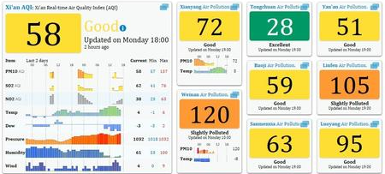
三、国际经验综述 3. International Experiences
● 以科学为依据制定政策，可推动形成强大的环境治理体系，该体系具有灵活性、充满活力，以事实支撑，并以结果为导向，最适于解决传统治理体系无法解决的一些问题。
● 数据的可得性和透明度是进行有效环境治理的关键要素。数据应具有可靠性、便于使用，具有统一的形式，以便用于评估问题、监测进展、有效监督和促进守规、推动创新，并通过参与及社会监督的方式推动社会治理。
● 建立环境绩效评估方法和标准及独立仲裁机构体系，以便公平地确保每个实施主体的利益、权力和目标。
Science driven policy making
Data availability and transparency: reliable, accessible & integrated to properly assess problems & monitor progress, monitor & enforce compliance, drive innovation & assist in promoting social governance.
Nationally systemize methods and standards for env’l performance assessments & independent arbitration bodies to fairly ensure the interests, authority & objectives of each implementing entity (e.g. U.S Toxic Release Inventory)

Slide 13


三、国际经验综述 3. International Experiences
● 包括高层监督部门的审查和政策评估制度，及独立的评估机制，以监测和审视政策实施和进展情况，并据此调整制度措施。该机制对德国实施能源转型计划发挥了至关重要的作用。
● 增强环保意识。美国1969年颁布的国家环境政策法（NEPA）发挥了核心作用，提高了整个联邦政府的环保意识，并确保了在各机构和部门的决策制定中应考虑环境价值。要求联邦机构为所有“显著影响人类生存环境质量的大型联邦行动”，如土地利用、能源生产、交通运输和生态系统等具有大规模环境影响的联邦行动进行环境影响分析（EIS），并评估其可能的替代方案，从而加大各项联邦行动的透明度和公众参与程度。
(iv) Monitor, assess, & evaluate policy implementation & progress & adjust institutional measures where appropriate. Link to continuous performance improvements. These mechanisms are critical if Germany is to meet its ambitious energy reforms through its Energiewende.
(v) Enhance awareness of env’l protection needs for constructive public involvement. U.S. National Environmental Protection Policy Act (NEPA) 1969 ensured that environmental values were taken into account in agency and departmental decision making. Environmental impact assessments (EISs) required for all ‘major federal actions significantly affecting the quality of the human environment’. Important for transparency and public engagement and analysis of environmental impacts and evaluations of alternatives.

Slide 14

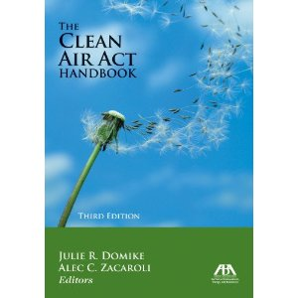
三、国际经验综述 3. International Experiences
● 强化激励机制，可以成功转变人们的行为。例如日本实施的商业领跑者计划，显著减少了能源消耗。
● 区域性污染物治理的政策和制度。根据美国的《清洁空气法》，美国环保署已经通过减少州内污染物排放，以及与跨州界污染运输的区域控制相结合的手段，成功实现了空气质量的改善。
● 联邦体制内的政策协调。澳大利亚2007年通过的《国家水法令》，美国通过清洁空气合作性联邦框架，制订了成功解决区域性/流域性环境挑战的法规措施。
(vi) Strengthening incentive structures has successfully changed behaviours as demonstrated in the Top Runner Program in Japan that has reduced energy use.
(vii) Policies and institutions for governing regional transport of pollutants. Under the U.S Clean Air Act, the EPA successfully led air quality improvements that relied both on in-state emission reductions and regional scale controls for pollution transported across state boundaries.
(viii) Policy coordination within federal systems is critical. Australia & the United States have successfully introduced statutory measures to address regional & catchment based env’l challenges (Australian National Water Act, 2007; U.S Clean Air Cooperative Federalism Framework).
ReefBlitz, involves both private organizations and the community in monitoring and working to improve the health of the Great Barrier Reef

Slide 15
四、主要政策建议 4. Policy Recommendations
一、动员各方面的力量建设生态文明，明确职责，协调政策，整合目标，形成合力。1、国务院制定新的政府部门“三定”方案，明确各部门特别是综合部门生态文明建设的职能，贯彻资源节约、环境友好的要求。将环境质量作为地方政府政绩考核的硬约束，组织第三方对有关部委及地方政府环保工作进行评估，结果公开。2、建立由国务院主管领导任主任的国务院环境保护委员会（或国务院可持续发展委员会），指导协调各部门的环境保护工作，指导协调跨区域、流域生态环境保护工作，对各部门及地方政府的环境绩效进行奖惩。3、整合国务院各部门污染防治和有关生态保护的职能，突出环境保护部门统一、独立的监督执法权力。
Recommendation 1: Mobilize governmental, social & economic resources to build EC. Clearly define responsibilities, establish coordination mechanisms & policies, develop integrated goals, and form synergies.
(i) Clarify EC responsibilities of all State Council departments. Environmental quality improvement-based performance evaluation for local governments. Third party independent evaluation of the performance of ministries and local governments.
(ii) Establish State Council Environmental Protection Committee (or State Council Sustainable Development Committee) to coordinate across departments & regional env’l protection activities, & incentive & penalize ministries & local governments according to their env’l performance.
(iii) Integrate scattered pollution prevention & control & ecological protection functions in a more unified structure that provides independent supervision and enhanced enforcement power.

Slide 16
四、主要政策建议 4. Policy Recommendations
二、建立有利于环境保护的激励机制。1、落实国家鼓励环境保护的各项财税、物价、金融政策。确保财政投入环保资金增长率不低于财政收入增长率。设立专项环境污染治理基金。鼓励公私合作模式（PPP）建设运营环境基础设施。2、建立企业环境信用评价体系，对遵守法规的企业给予鼓励，对大量中小企业提供治理服务平台。3、积极推动行业、企业自愿追求良好环境绩效的行动。4、坚持“谁污染谁付费，谁破坏谁赔偿，谁保护谁受益”的原则，加快推进和完善生态补偿制度，调动地方政府特别是财政困难地区保护环境的积极性。
Recommendation 2: Establish incentive mechanisms to promote env’l protection.
(i) Implement national fiscal, taxation, pricing & financial policies that encourage env’l protection. Growth in fiscal budget for env’l protection should not be lower than revenue growth. Set up environmental pollution remediation funds. Encourage public-private partnerships (PPP).
(ii) Establish an Enterprise Env’l Credit Evaluation System. Set up a pollution treatment services information platform targeting small and medium sized enterprises (SMEs).
(iii) Promote industries and enterprises’ voluntary pursuit of good env’l performance, through programs like the Green Supply Program and the Top Runner Program.
(iv) According to the principles of ‘he who pollutes pays, he who damages compensates, he who protects benefits,’ set up an eco-compensation mechanism, & mobilize local governments for env’l protection, especially in areas experiencing fiscal difficulties.

Slide 17

四、主要政策建议 4. Policy Recommendations
三、加强环境保护社会治理，形成多元共治格局。努力形成政府主导的多元共治格局，是解决中国环境问题的治本之策。1、优先制定落实公众参与、信息公开、环境诉讼的具体制度。认真执行环境信息报告和公开制度，使环境保护制度在科学的基础上、在法律的约束下、在公开透明的条件中得到有效的执行。2、培育发挥环保社会组织的作用，营造有利于其发展的社会环境。3、鼓励基层组织关注环境问题的治理，反映公众环境诉求，制定环境保护的社规民约，倡导绿色生活方式。
Recommendation 3: Strengthen social governance for env’l protection and develop a multi-stakeholder governance model.
(i) Develop and implement systems for public participation, information disclosure & env’l litigation as required by the new Env’l Protection Law. Implement open and transparent env’l information reporting and disclosure of pollution discharges, pollution treatment and potential env’l risks and ensure effective enforcement.
(ii) Encourage env’l protection social organizations to play a role and create a social environment and the legal conditions to facilitate their development.
(iii) Encourage grassroots organizations to focus on env’l management issues, embrace the public’s env’l demands, develop community by-laws for env’l protection, & advocate green lifestyles.

Slide 18
四、主要政策建议 4. Policy Recommendations
四、使环境保护部门的权威、能力和资源与其监督管理职责及任务相匹配。1、落实环境保护主管部门“统一监督管理”的规定，国务院制定相关行政法规，明确规定环保部门监督同级政府相关部门及下级政府环保工作的权责及工作程序。2、建立统一的环境信息平台，实现及时准确的数据信息共享。建立环保部统一管理的国家环境质量监测网，改革环境统计制度。3、加大财政对环保科学研究、监测及信息化能力、监督执法能力的支持，鼓励社会化方式提供各种环境服务。增加环保部门公务员编制，提高执法人员素质，尽快作出环境管理执法人员尽职免责的司法解释。
Recommendation 4: Match env’l protection departments’ authority, capacity, & resources to their supervision and management functions & tasks.
(i) State Council should specify environmental protection departments’ authorities to supervise the env’l protection activities of other departments and local governments.
(ii) Establish a unified environmental information platform to achieve timely and accurate data sharing. Set up a national environmental quality monitoring network under the management of the Ministry of Environmental Protection.
(iii) Increase fiscal investments in environmental scientific research, monitoring & information gathering, & supervision & enforcement capacities. Encourage provision of env’l services through market mechanisms.
(iv) Increase overall number & capability of env’l protection departments’ civil servants to match their workload and statutory responsibilities. Prescribe env’l law enforcement duties; offer training.

Slide 19
四、主要政策建议 4. Policy Recommendations
五、以提高效率、确保制度有效实施为目标，改革整合环境管理制度。重新审视环境管理制度的科学性和合理性，及时修订环保法律和制度。1、研究制定包括主要污染物排放、煤炭消费、二氧化碳排放的全面总量控制制度。探索实施以环境容量为基础的区域性、流域性污染物总量控制制度和行业污染物总量控制制度。2、出台污染物排放许可制度相关法规和实施细则，将排污单位纳入统一监管。改革环境影响评价制度，废除“三同时制度”，做好与排污许可制度的衔接。环境影响评价制度应重点用于战略、规划、政策和国家跨区域流域对生态环境有重大影响项目的评价。3、完善环境与健康相关制度，健全环境公益诉讼制度，强化生态环境损害赔偿和责任追究。强化司法系统追究环境违法行为的责任和能力。
Recommendation 5: Integrate env’l management institutions for efficiency and effectiveness.
(i) Implement a comprehensive total emission control system for primary pollutants & CO₂ emissions from fossil fuel consumption. Explore & implement regional, river-basin & sectoral total emission control systems based on each region’s env’l carrying capacity.
(ii) Develop laws & regulations for an emission permit system. Cover all pollution discharging entities. Reform environmental impact assessment (EIA) system to achieve more effective integration with pollution permitting system & apply to strategies, plans & policies & cross-regional & river basin projects that may have significant ecological impacts.
(iii) Improve environment & health related institutions, env’l public interest litigation system & ecological environment damage compensation & accountability systems. Strengthen investigative efforts & penalties for env’l matters involving criminal liability. Ensure sanctions reflect offense.

Slide 20

四、主要政策建议 4. Policy Recommendations
六、对国合会下一步研究课题的建议。1、健全国家环境治理体系、提升国家环境治理能力，特别是加强环境社会治理的研究；2、政府及有关部门环境绩效第三方评估、企业环境信用第三方评估的制度建设研究；3、环境保护制度体系构建及顶层设计研究；4、环境保护激励政策和制度研究；5、重要污染防治制度（如环境影响评价、污染物排放总量控制、排污收费制度）实施情况评估及制度改革研究；6、《奥胡斯公约》及环保公众参与国际经验的研究。
Recommendation 6: Recommendations for further CCICED studies.
(i) strengthening the env’l governance system & governance capacity, esp. social governance;
(ii) on third party evaluation of govt’l env’l performance, & env’l credit rating of enterprises;
(iii) Top-level design and construction of env’l protection institutions;
(iv) Incentive policies and mechanisms to promote env’l protection;
(v) Evaluating the reform and implementation of pollution control institutions;
(vi) Aarhus Convention and international experiences on public participation in env’l protection & multi-stakeholder governance.

Slide 21
Thank You !
课题组成员
中外组长*:
王玉庆 中国环境科学学会理事长
罗宾·克拉克 澳大利亚可持续发展、环境、
水务、人口与社区部前秘书长
中外成员*:
夏 光 环保部环境与经济政策研究中
心主任
彭近新 中国环境科学学会常务理事
张 全 上海市环保局局长
马 中 中国人民大学环境学院院长
王 毅 中国科学院科技政策与管理科
学研究所所长
丽莎·杰克逊 苹果公司环境事务副总裁，
美国环保署前署长
杜丹德 美国环保协会副总裁
克里尼 意大利环境、领土与海洋部前
部长
米兰达·施鲁尔 德国柏林自由大学环境政策
研究中心主任
协调员:
王佩珅 世界银行环境专家
周 涛 中国环境科学学会高级工程师
Task Force Members
Co-chairs*:
WANG Yuqing, President of Chinese Society for Environmental Sciences
Robyn Kruk, Former Secretary of Department of Sustainability, Environment, Water, Population and Communities, Australian Government
Task Force Members*:
XIA Guang, Director General, Policy Research Center for Environment and Economy, Ministry of Environmental Protection
PENG Jinxin, Standing Director, China Environmental Sciences Society
ZHANG Quan, Director General, Shanghai Environmental Protection Bureau
MA Zhong, Dean and Professor, School of Environment and Natural Resources, Renmin University of China
WANG Yi, Deputy Director-General, Institute of Policy and Management , Chinese Academy of Sciences
Lisa Jackson, Vice President, Environmental Initiatives, Apple Inc.
Daniel J. DudeK, Vice President, Environmental Defense Fund, USA
Corrado Clini, Former Minister, Ministry for the Environment, Land and Sea, Italy
Miranda A. Schreurs, Professor and Director Environmental Policy Research Centre, Freie Universität Berlin
Coordinators:
ZHOU Tao, Chinese Coordinator, Research Associate , CSES
WANG Peishen, International Coordinator, Consultant and former Sr. Environmental Specialist of The World Bank

